Slide 1
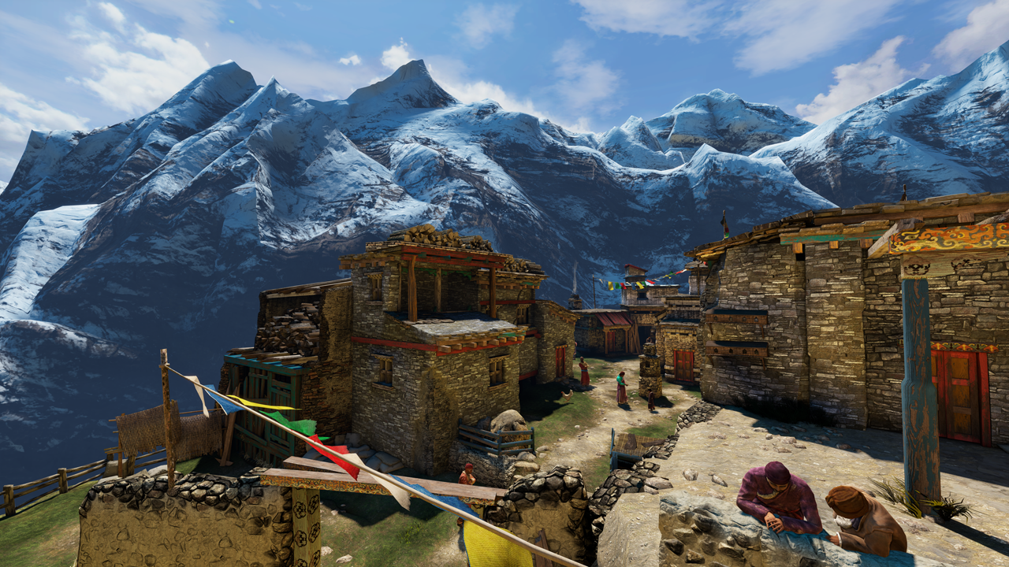
Uncharted 2: HDR Lighting
John Hable
Naughty Dog
Notes:
1
1
1
1
1
1

Slide 2
Agenda
Gamma/Linear-Space Lighting
Filmic Tonemapping
SSAO
Rendering Architecture/How it all fits together.
Notes:
2
2
2
2
2
2

Slide 3
Skeletons in the Closet
Used to work for EA Black Box (Vancouver)‏
Ucap Project
I.e. Tiger Woods's Face
Also used to work for EA Los Angeles
LMNO (Spielberg Project)‏
Not PQRS (Boom Blox)‏
Now at Naughty Dog
Uncharted 2
Notes:
3
3
3
3
3
3

Slide 4
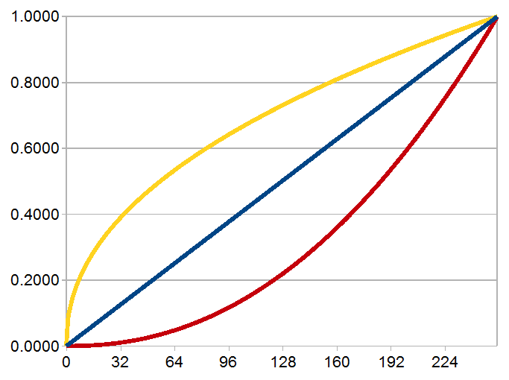
Part 1: Gamma!
Notes:
4
4
4
4
4
4

Slide 5
Gamma
Mostly solved in Film Industry after lots of kicking and screaming
Never heard about it in college
George Borshukov taught it to me back at EA
Matrix Sequels
Issue is getting more traction now
Eugene d’Eon’s chapter in GPU Gems 3
Notes:
5
5
5
5
5
5

Slide 6

Demo
What is halfway between white and black
Suppose we show alternating light/dark lines.
If we squint, we get half the linear intensity.
Notes:
6
6
6
6
6
6

Slide 7
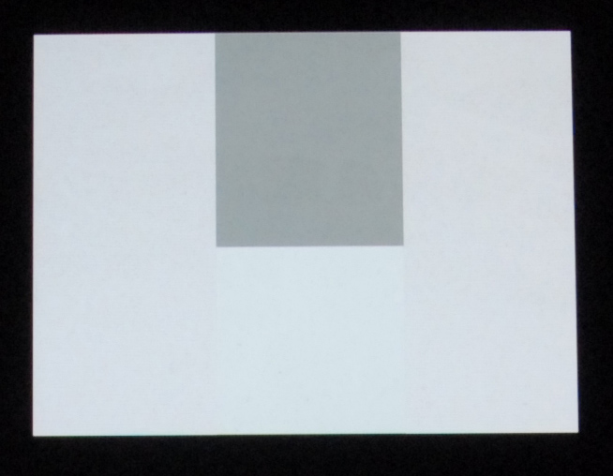
Demo
Test image with 4 rectangles.
Real image of a computer screen shot from my camera.
Notes:
7
7
7
7
7
7
First check out Lines1.png. The left and right side are alternating lines of white and black, so if you step back a few feet, it should look like gray. Notice how the grey box in the middle top is much darker than the left or right, but the middle-bottom box should match pretty closesly. What color is that bottom box?
Now check out Lines2.png. So why is the 187 box about as bright as half of 255?

Slide 8
Demo
Alternating lines of black and white (0 and 255).
Notes:
8
8
8
8
8
8

Slide 9
Demo
So if the left and right are alternating lines of 0 and 255, then what color is the rectangle with the blue dot?
Notes:
9
9
9
9
9
9

Slide 10
Demo
Common wrong answer: 127/128.
That’s the box on the top.
128
Notes:
10
10
10
10
10
10

Slide 11
Demo
Correct answer is 187.
WTF?
128
187
Notes:
11
11
11
11
11
11

Slide 12

Color Ramp
You have seen this before.
0
127
255
187
Notes:
12
12
12
12

Slide 13
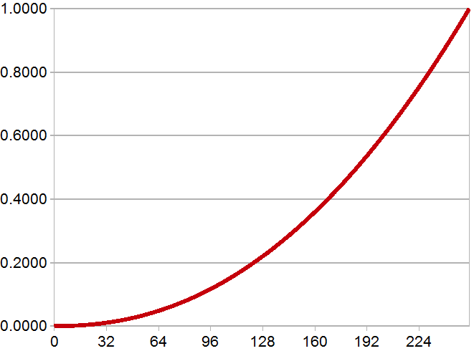
Gamma Lines
255
F(x) = pow(x,2.2)‏
187
127
0
Notes:
13
13
13
13

Slide 14
What is Gamma
Gamma of 0.45, 1, 2.2
Our monitors are the red one
Notes:
14
14
14
14
14
14
Here is what the gamma curves look like, with a power of 1, 2.2, and 0.45, which is about 1/2.2.

Slide 15

We all love mink...
F(x) = x
Notes:
15
15
15
15
15
15
Here is a liner curve.

Slide 16
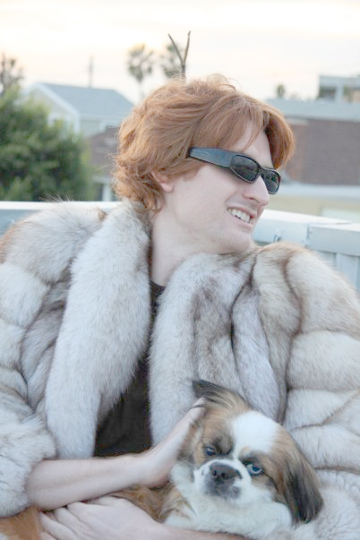
We all love mink...
F(x) = pow(x,0.45) note: .45 ~= 1/2.2‏
Notes:
16
16
16
16
16
16
And a power of 0.45. This looks bright and pastel-ish.

Slide 17
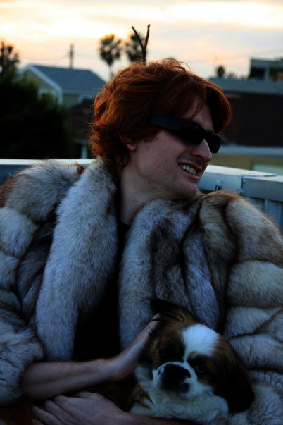
We all love mink...
F(x) = pow(x,2.2)‏
Notes:
17
17
17
17
17
17
And a power of 2.2. This one is dark and contrasty.

Slide 18

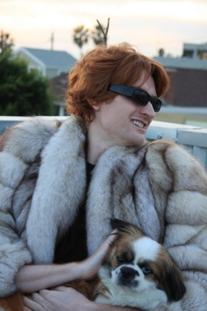

What is Gamma
Get to know these curves…
Notes:
18
18
18
18
18
18
That’s what the curves do to images.

Slide 19


What is Gamma
Back and forth between curves.
2.2
2.2
.45
.45
Notes:
19
19
19
19
19

Slide 20

How bad is it?
Your monitor has a gamma of about 2.2
So if you output the left image to the framebuffer, it will actually look like the one right.
2.2
Notes:
20
20
20
20
20

Slide 21
Let’s build a Camera…
A linear camera.
Actual
Light
Monitor
Output
1.0
2.2
Hard
Drive
Notes:
21
21
21
21
21

Slide 22
Let’s build a Camera…
Any consumer camera.
Actual
Light
Monitor
Output
.45
2.2
Hard
Drive
Notes:
22
22
22
22
22

Slide 23
How to fix this?
Your screen displays a gamma of 2.2
This is stored on your hard drive.
You never see this image, but it’s on your hard drive.
2.2
Notes:
23
23
23
23
23

Slide 24
What is Gamma
Curves again.
Notes:
24
24
24
24
24
24

Slide 25
What is Gamma
Q) Why not just store as linear?
A) Our eyes perceive more data in the blacks.
Notes:
25
25
25
25
25
25
A common question I get is: “Why not just store images as linear?”

Slide 26


How bad is it?
Suppose we look at the 0-63 range.
What if displays were linear?
Notes:
26
26
26
26
26

Slide 27
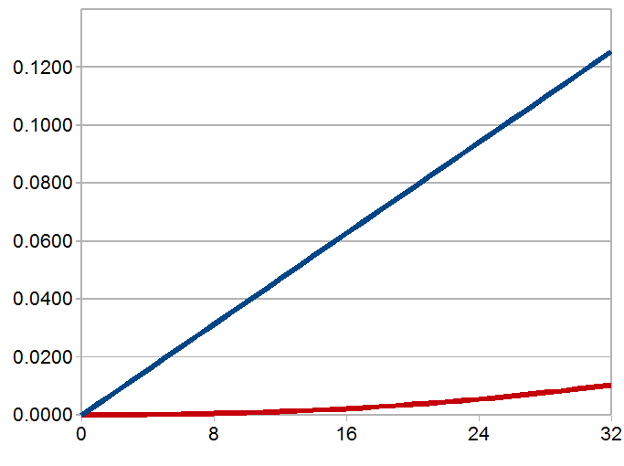
Gamma
Gamma of 2.2 gives us more dark colors.
Notes:
27
27
27
27
27
27
You see, with a gamma of 2.2, we have about 32 shades of brey between 0 and 0.01. But a linear curve only has about 3.

Slide 28
How bad is it?
If displays were linear:
On a scale from 0-255
0 would equal 0
1 would equal our current value of 20
2 would equal our current value of 28
3 would equal our current value of 33
Darkest Values:
Notes:
28
28
28
28
28
28
As it stands, assuming a perfect gamma 2.2, we currently have 19 shades of grey in between black and that first shade of grey. With a linear curve, we have 0. So the gamma curve gets us better blacks at the expense of less precision in the whites.

Slide 29
Ramp Again
See any banding in the whites?
Notes:
29
29
29
29
29
29
But as it stands, our whites look fine, and if anything, the blacks have banding. We could use a linear curve, which would give us terrible banding in the darks, but better precision in the whites, but that would be a horrible tradeoff.

Slide 30
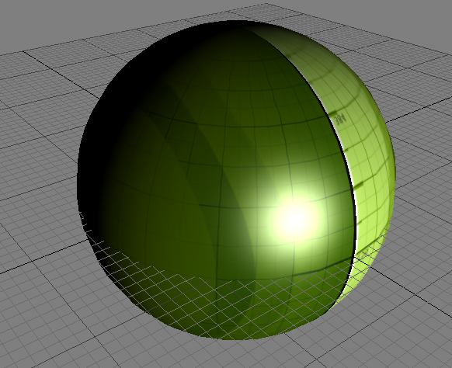
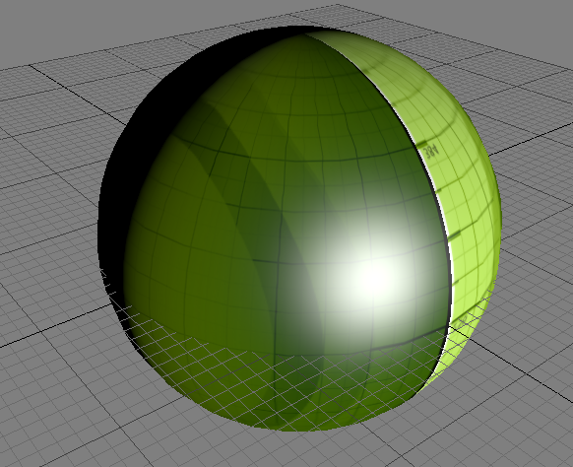
3D Graphics
If your game is not gamma correct, it looks like the image on the left..
Note: we’re talking about “correct”, not “good”
Notes:
30
30
30
30
30
30
Here is the default sphere from FX Composer 1.7. So how does gamma relate to us? Well, if your game does lighting in gamma space, it looks like the image on the left. If you are in linear, it looks like the image on the right. Notice how the specular highlight shifts from white, to yellow, to green-ish, to yellow-ish. Whereas the linear space version looks like a green object with a white specular highlight.

Slide 31
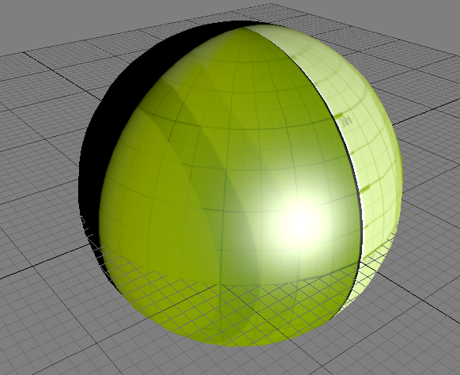
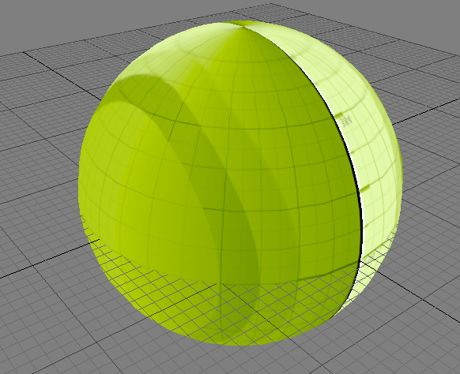
3D Graphics
Here's what is going on.
Hard
Drive
Screen
Lighting
Notes:
31
31
31
31
31

Slide 32
3D Graphics
Account for gamma when reading textures
color = pow( tex2D( Sampler, Uv ), 2.2 )‏
Do your lighting calculations
Account for gamma on color output
finalcolor = pow( color, 1/2.2 )‏
Notes:
32
32
32
32
32

Slide 33
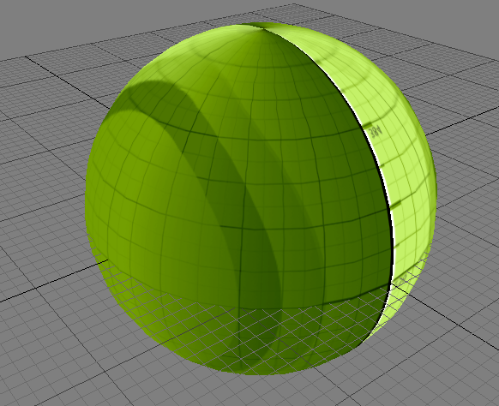
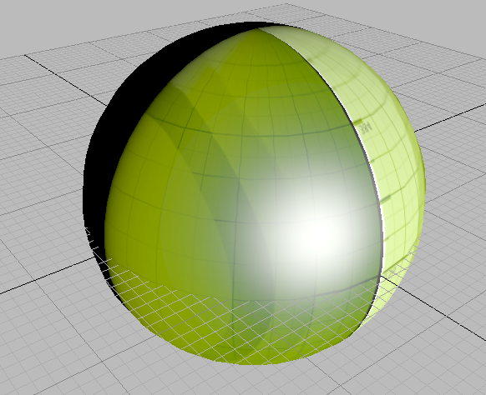
3D Graphics
Here's what is going on.
Monitor
Adjust
Hard
Drive
Lighting
Gamma
Shader
Correct
Notes:
33
33
33
33
33

Slide 34
3D Graphics
Comparison again...
Notes:
34
34
34
34
34
34
Here is the comparison again.

Slide 35
3D Graphics
The Wrong Shader?
Spec = CalSpec();
Diff = tex2D( Sampler, UV );
Color = Diff * max( 0, dot( N, L ) ) + Spec;
return Color;
Notes:
35
35
35
35
35
35
Here is the wrong shader.

Slide 36
3D Graphics
The Right Shader?
Spec = CalSpec();
Diff = pow( tex2D( Sampler, UV ), 2.2 );
Color = Diff * max( 0, dot( N, L ) ) + Spec;
return pow( Color, 1/2.2);
Notes:
36
36
36
36
36
36
And here is the correct shader.

Slide 37
3D Graphics
But, there is hardware to do this for us.
Hardware does sampling for free
For Texture read:
D3DSAMP_SRGBTEXTURE
For RenderTarget write:
D3DRS_SRGBWRITEENABLE
Notes:
37
37
37
37
37
37
But of course we don’t actually want to perform the power 2.2 because it’s expensive. So the hardware vendors made render states to do this conversion for us for free!

Slide 38
3D Graphics
With those states we can remove the pow functions.
Spec = CalSpec();
Diff = tex2D( Sampler, UV );
Color = Diff * max( 0, dot( N, L ) ) + Spec;
return Color;
Notes:
38
38
38
38
38
38
Good bye pow function.

Slide 39
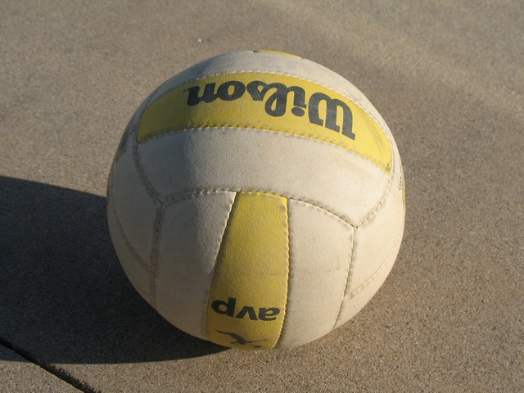
3D Graphics
What does the real world look like?
Notice the harsh line.
Notes:
39
39
39
39
39
39
One common question I get is that artists don’t like the harsh linear falloff…they like the softer falloff better. Well, in the real world, objects have a harsh falloff. And it actually looks awesome if you do it right.

Slide 40
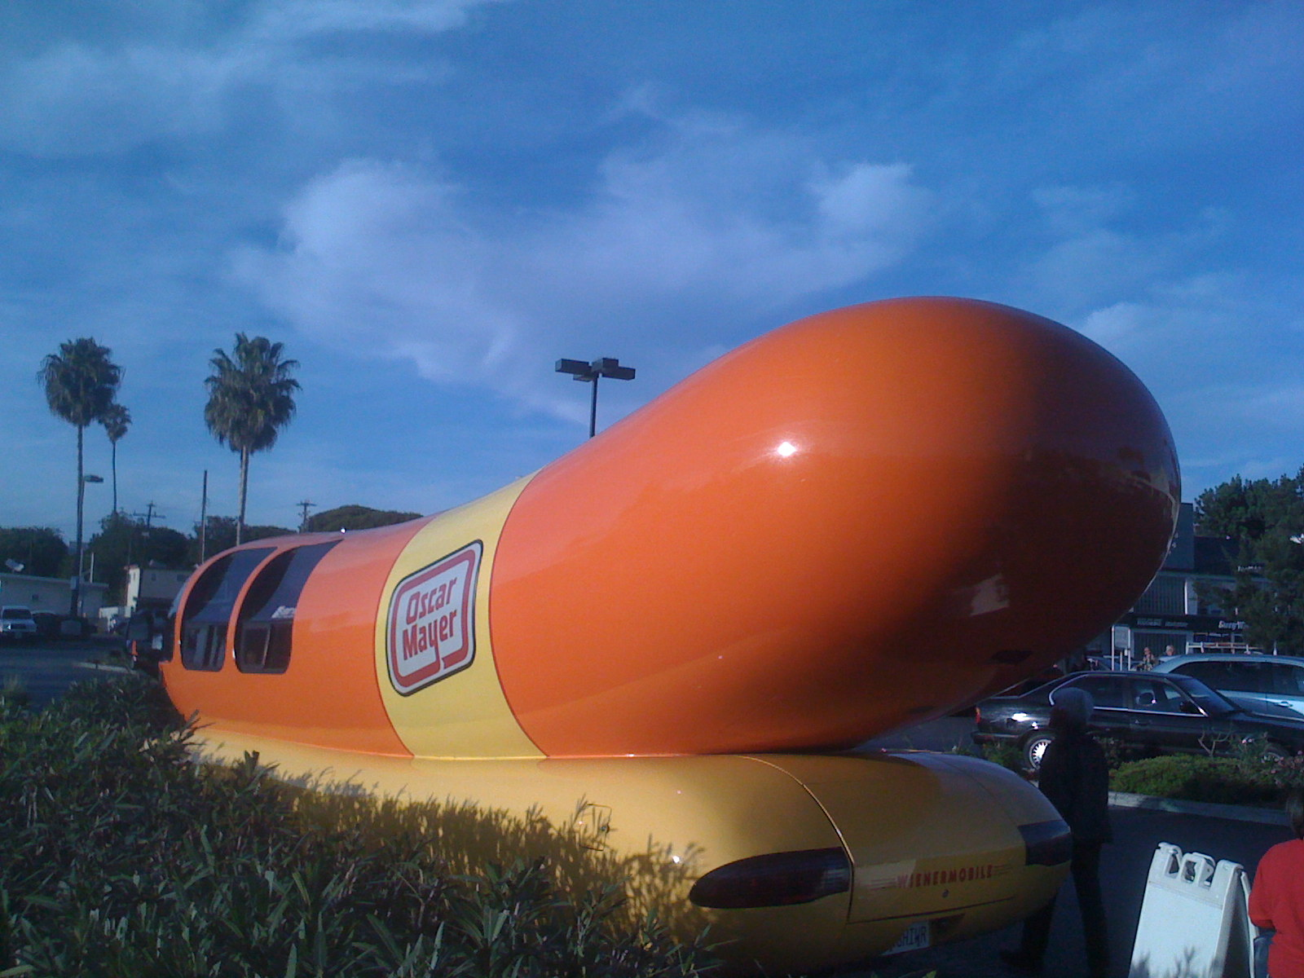
3D Graphics
Another Example
Notes:
40
40
40
40
40
40

Slide 41
FAQs
Q1) But I like the soft falloff!
A1) Don’t be so sure.
Notes:
41
41
41
41
41
41
Also, you are allowed to change the falloff of your shader to something less harsh. In general, I think you shouldn’t, but it’s better than doing everything in gamma space just because you like one side-effect.

Slide 42
FAQs
It looks like the one on top before the monitor’s 2.2
Notes:
42
42
42
42
42
42

Slide 43
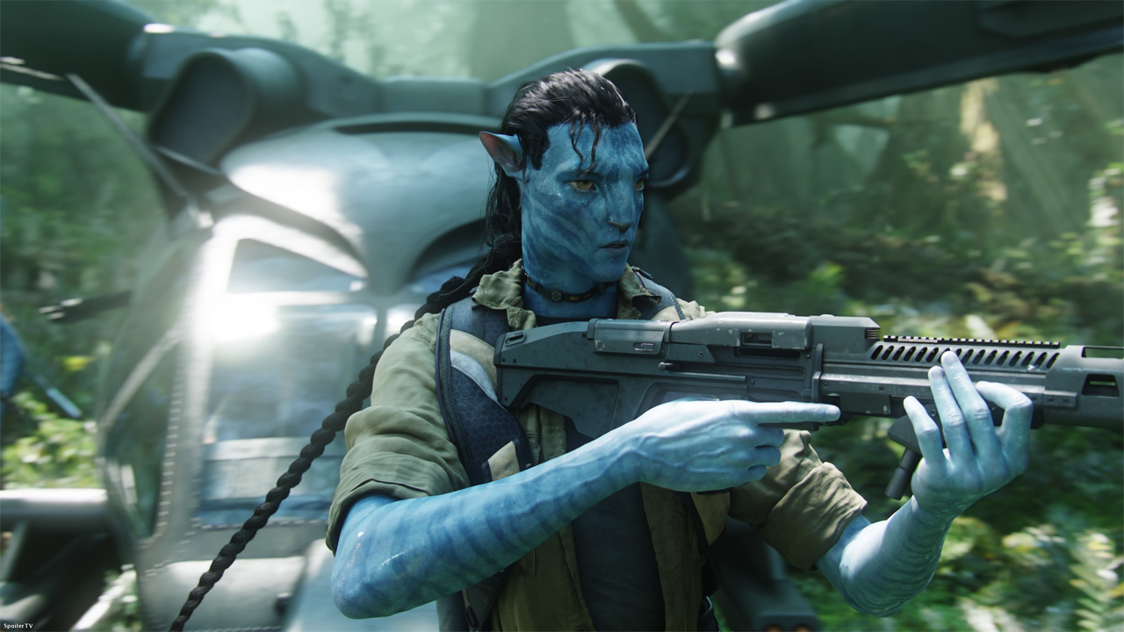
Harsh Falloff
Devastating.
Notes:
43
43
43
43
43
43

Slide 44
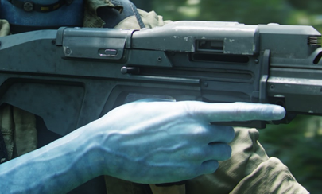
Harsh Falloff
Devastating.
Notes:
44
44
44
44
44
44

Slide 45
Harsh Falloff
Devastating.
Notes:
45
45
45
45
45
45

Slide 46
Which Maps?
Which maps should be Linear-Space vs Gamma-Space?
Gamma-Space
Use sRGB hardware or pow(2.2) on read
128 ~= 0.2
Linear-Space
Don’t use sRGB or pow(2.2) on read
128 = 0.5
Notes:
46
46
46
46
46
46

Slide 47
Which Maps?
Diffuse Map
Definitely Gamma
Normal Map
Definitely Linear
Notes:
47
47
47
47
47
47

Slide 48
Which Maps?
Specular?
Uncharted 2 had them as Linear
Artists have trouble tweaking them to look right
Probably should be in Gamma
Notes:
48
48
48
48
48
48

Slide 49
Which Maps?
Ambient Occlusion
Technically, it’s a mathematical value like a normal map.
But artists tweak them a lot and bake extra lighting into them.
Uncharted 2 had them as Linear
Probably should be Gamma
Notes:
49
49
49
49
49
49

Slide 50
Exercise for the Reader
Gamma 2.2 != sRGB != Xenon PWL
sRGB: PC and PS3 gamma
Xenon PWL: Piecewise linear gamma
Notes:
50
50
50
50
50
50

Slide 51
Xenon Gotchas
Xbox 360 Gamma Curve is wonky
Way too bright at the low end.
HDR the Bungie Way, Chris Tchou
Post Processing in The Orange Box, Alex Vlachos
Output curve is extra contrasty
Henry LaBounta was going to talk about it.
Try hooking up your Xenon to a waveform monitor and display a test pattern. Prepare to be mortified.
Both factors counteract each other
Notes:
51
51
51
51
51
51

Slide 52
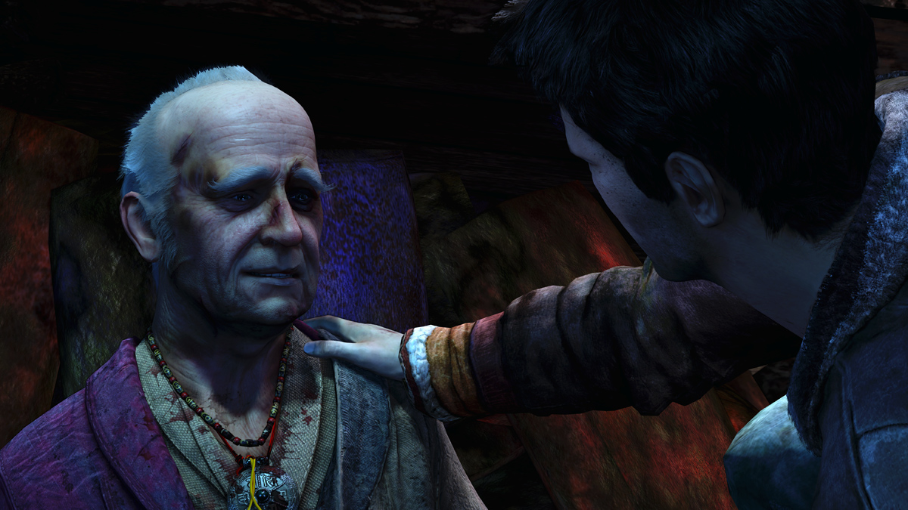
Linear-Space Lighting: Conclusion
“Drake! You must believe in linear-space lighting!”
Notes:
52
52
52
52
52
52

Slide 53
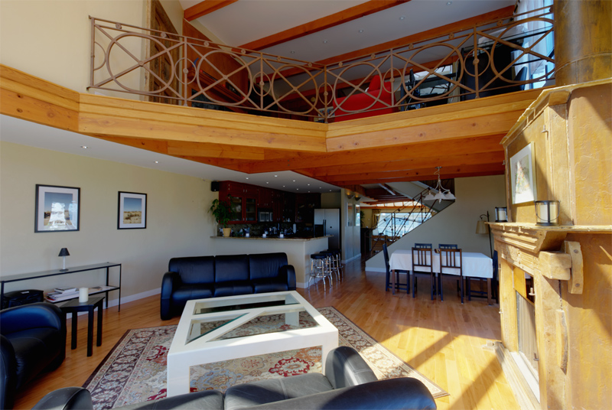
Part 2: Filmic Tonemaping
Notes:
53
53
53
53
53
53

Slide 54
Filmic Tonemapping
Let's talk about the magic of the human eye.
Notes:
54
54
54
54
54
54
Ok, so filmic tonemapping. First, let’s talk about the human eye.

Slide 55
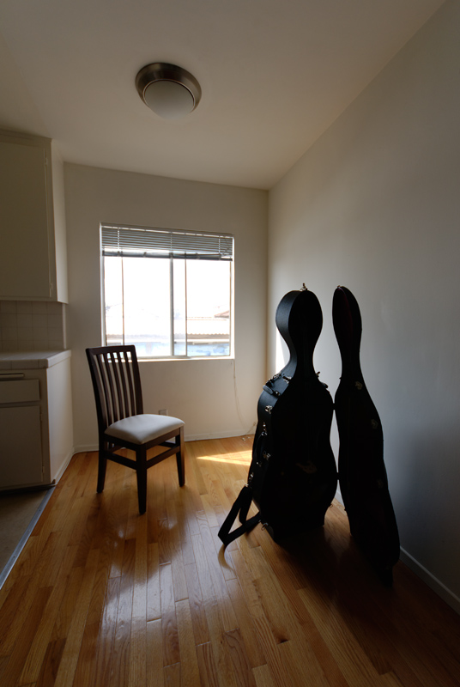
Filmic Tonemapping
Real example from my apartment.
Full Auto settings.
Outside blown out.
Cello case looks empty.
My eye somehow adjusts...
Notes:
55
55
55
55
55
55
This is the HDR problem in film. I’m standing inside my old apartment looking outside. The outside is completely overexposed, and my cello case is under-exposed. There is a cello in there but you can’t see it. But if you are actually standing there, you can see detail outdoors and inside the cello case just fine. Why?

Slide 56
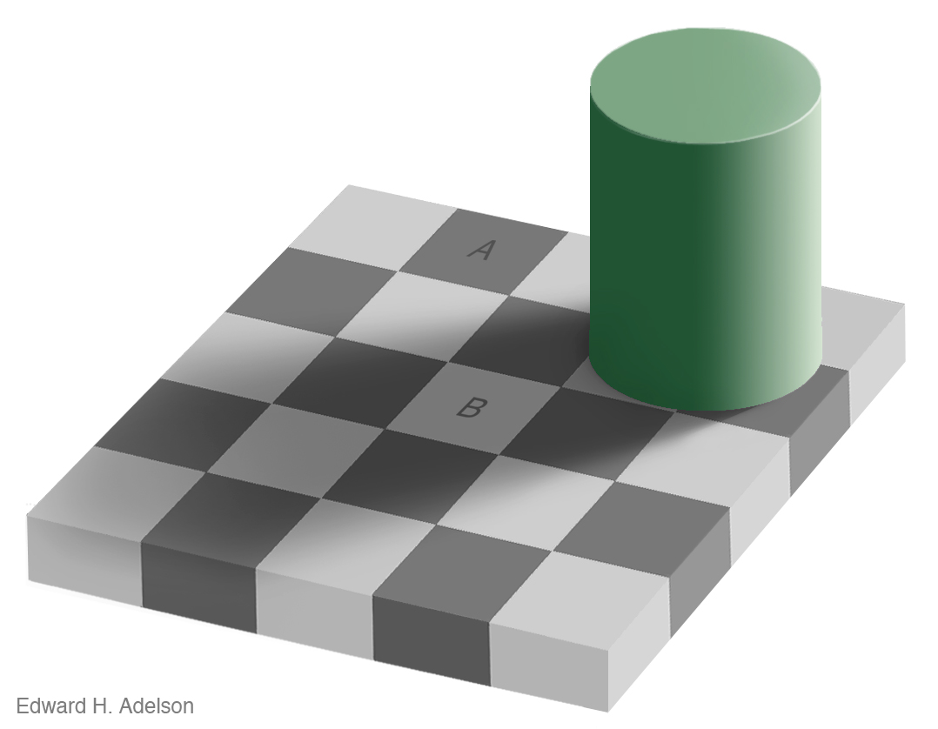
Filmic Tonemapping
Adaptiveness of human eye.
Notes:
56
56
56
56
56
56
The answer is that the iris in our eyes is locally adaptive. Here is my all time favorite optical illusion, the Adelson Checkeboard. The square marked A is actually the same intensity as the square marked B.

Slide 57
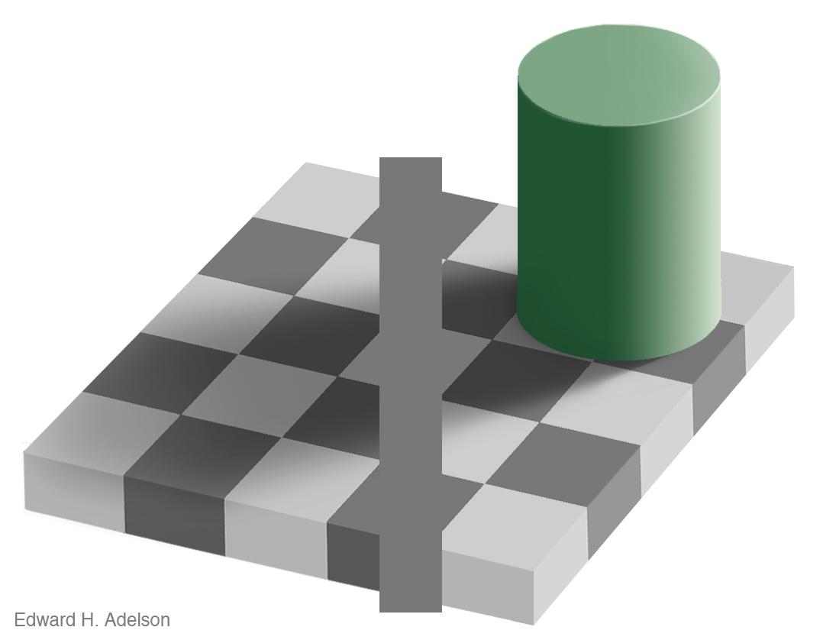
Filmic Tonemapping
Adaptiveness of human eye.
Notes:
57
57
57
57
57
57
You can see if it if you put a line through them.

Slide 58
Filmic Tonemapping
Adaptiveness of human eye.
Notes:
58
58
58
58
58
58
You can also block out the other squares to see that they are the same.

Slide 59
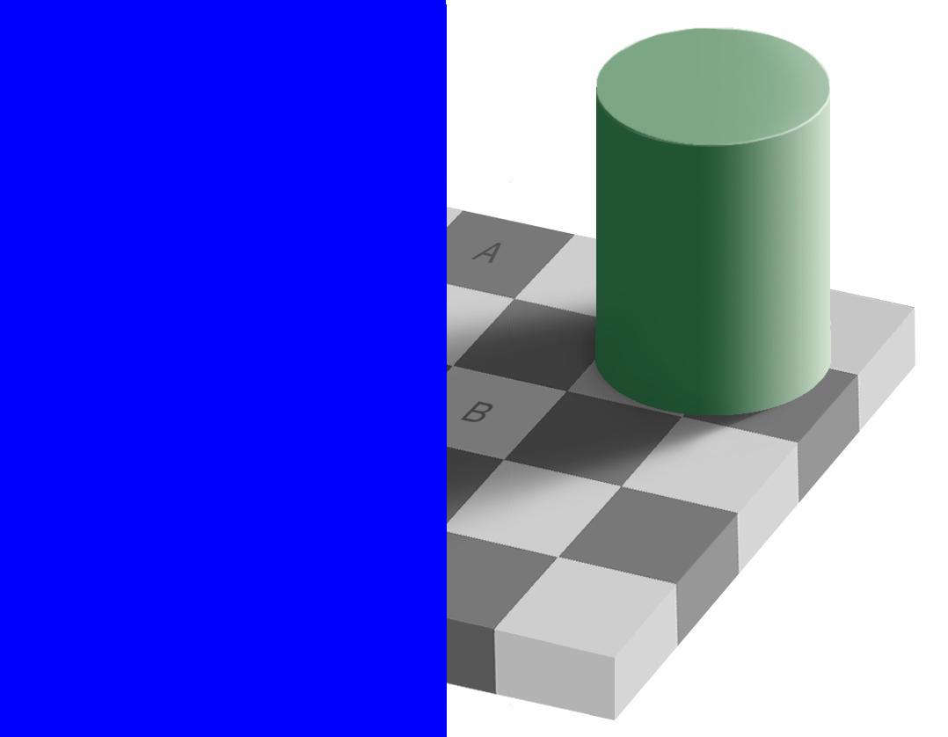
Filmic Tonemapping
Adaptiveness of human eye.
Notes:
59
59
59
59
59
59

Slide 60
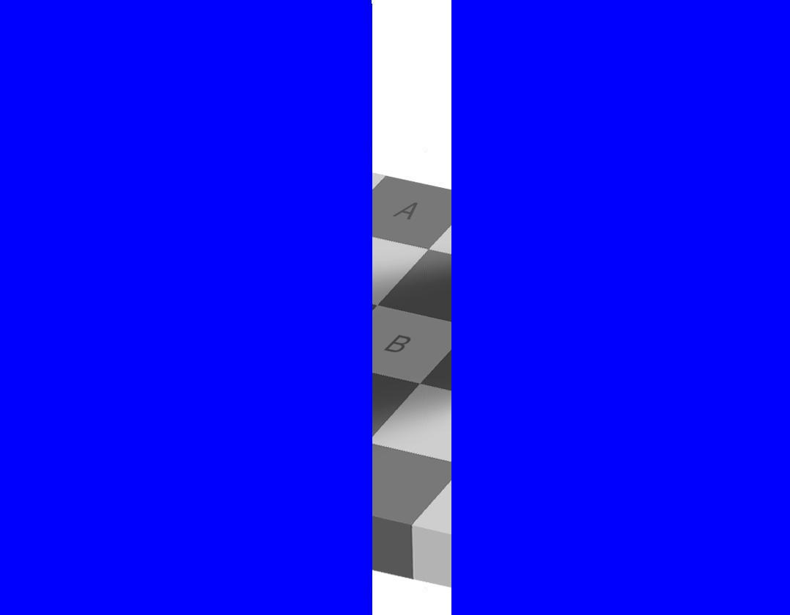
Filmic Tonemapping
Adaptiveness of human eye.
Notes:
60
60
60
60
60
60

Slide 61
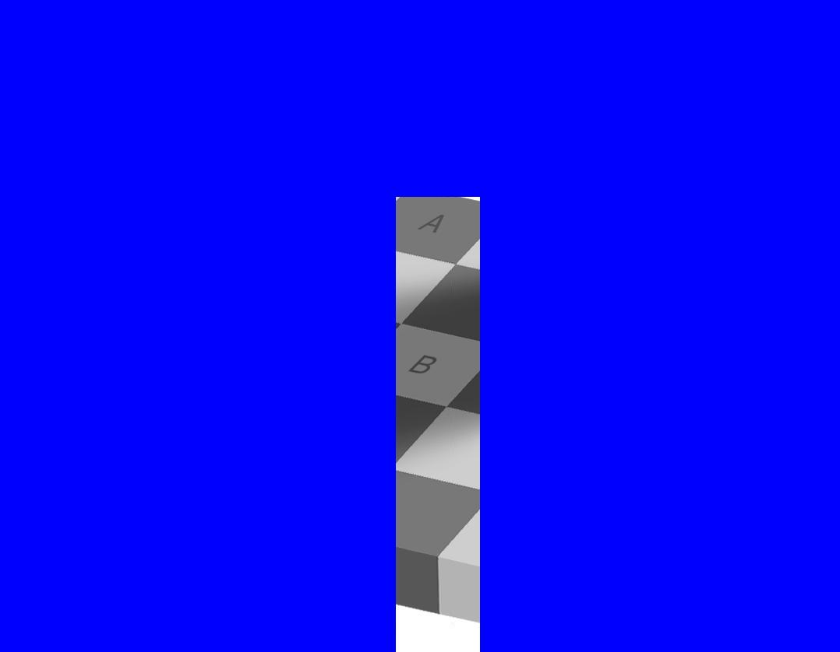
Filmic Tonemapping
Adaptiveness of human eye.
Notes:
61
61
61
61
61
61

Slide 62
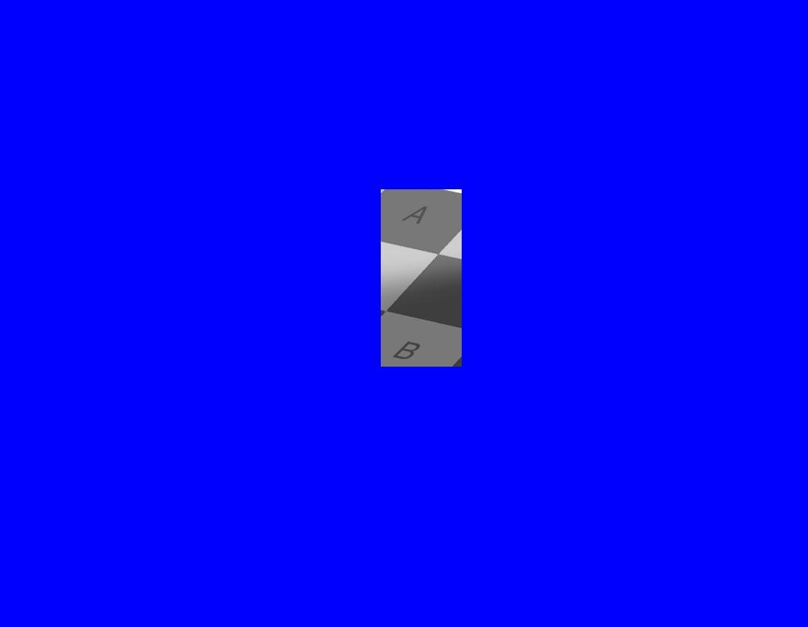
Filmic Tonemapping
Adaptiveness of human eye.
Notes:
62
62
62
62
62
62

Slide 63
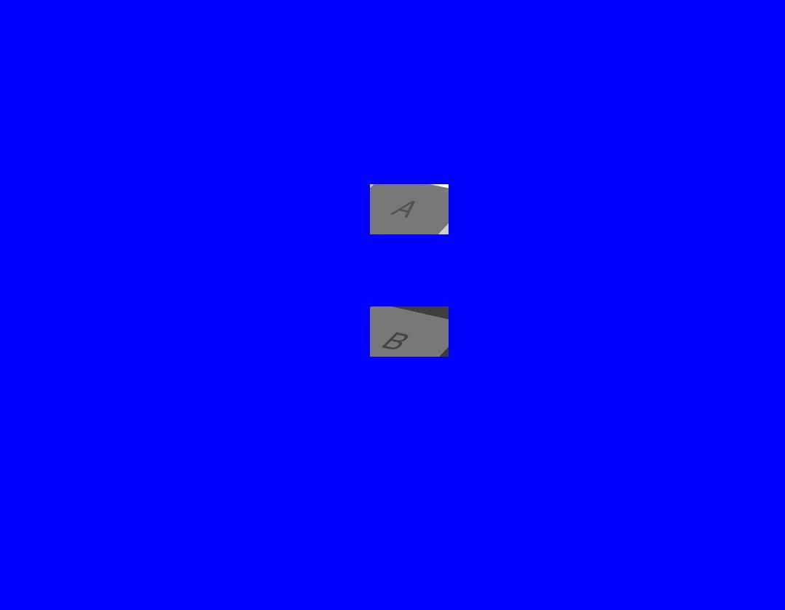
Filmic Tonemapping
Adaptiveness of human eye.
Notes:
63
63
63
63
63
63

Slide 64

Filmic Tonemapping
One more
Notes:
64
64
64
64
64
64
Here is another one. It looks like there is a gradient on the top and bottom going to the right, and that there is an opposite gradient, but not as bright, going to the left.

Slide 65


Filmic Tonemapping
One more
Notes:
65
65
65
65
65
65
Actually, there is no gradien in the middle one. Our eye perceptually adds that contrast.

Slide 66
Gamma
Let’s take an HDR image
Note: 1 F-Stop is a power of two
So 4 F-stops is 2^4=16x difference in intensity
Notes:
66
66
66
66
66
66
So let’s look at my apartment again.

Slide 67
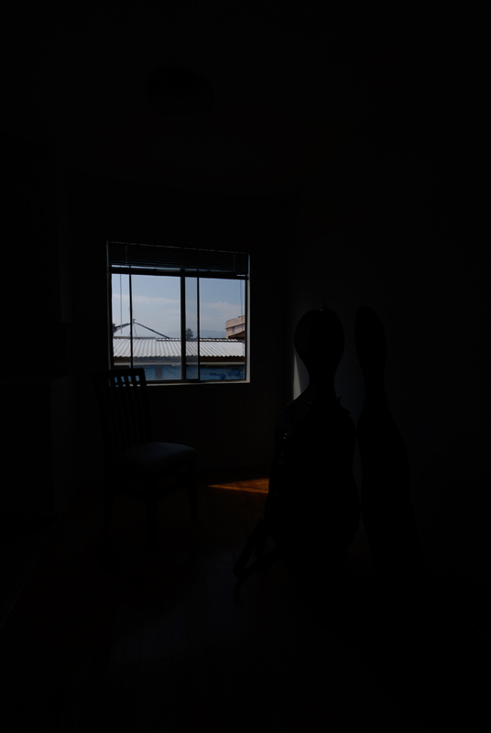
Gamma
Exposure: -4
Notes:
67
67
67
67
67
67
We’ll construct and HDR image using exposure bracketing. Here the sky is well exposed but everything else is too dark.

Slide 68
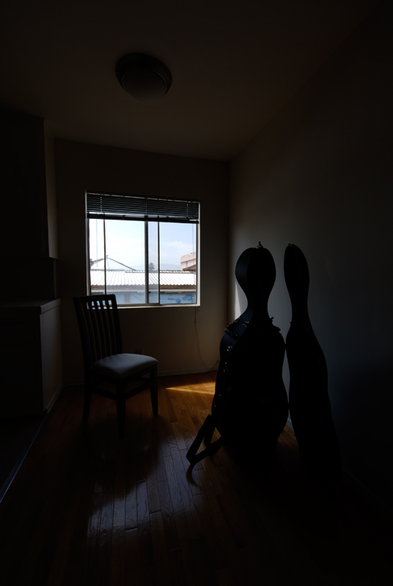
Gamma
Exposure: -2
Notes:
68
68
68
68
68
68

Slide 69
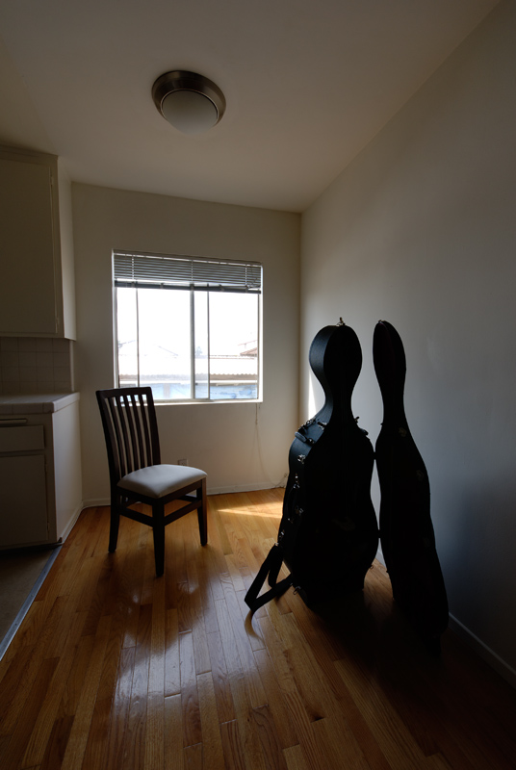
Gamma
Exposure: 0
Notes:
69
69
69
69
69
69

Slide 70
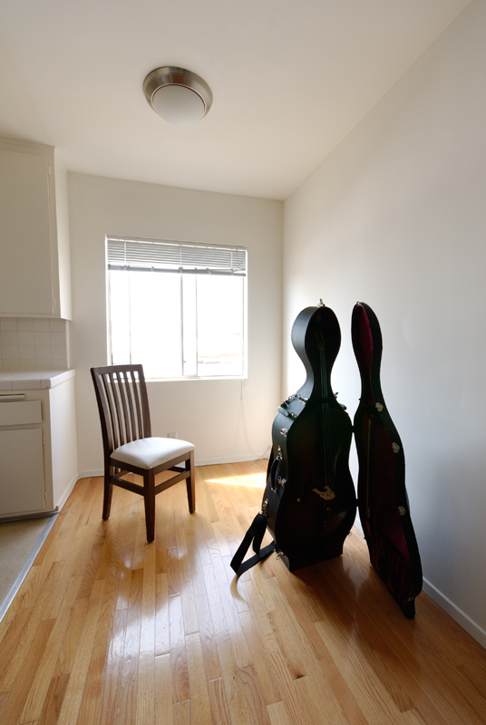
Gamma
Exposure: 2
Notes:
70
70
70
70
70
70

Slide 71
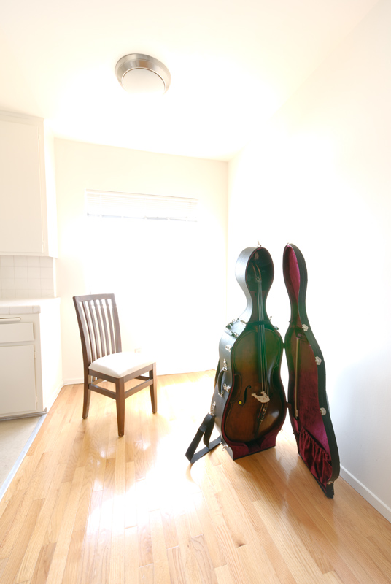
Gamma
Exposure: 4
Notes:
71
71
71
71
71
71
Check it out, my cello is actually in there, but you can’t see it until everything else is completely overexposed.

Slide 72
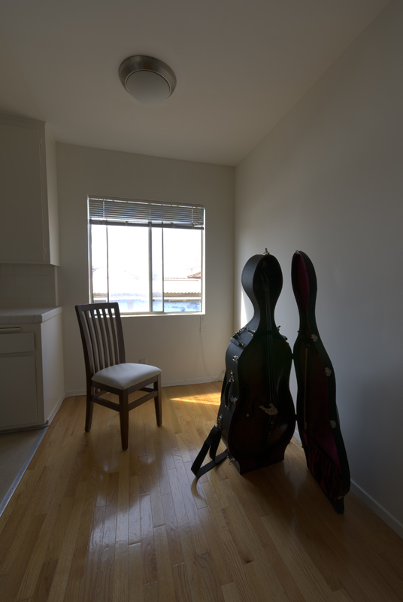
Now what?
We actually need 8 stops
Good News: HDR Image
Bad News: Now what?
Re-tweaking exposure won't help
Notes:
72
72
72
72
72
72
Now that we have an HDR image, what should we do with it? Well, simply choosing a different exposure doesn’t help us much.

Slide 73
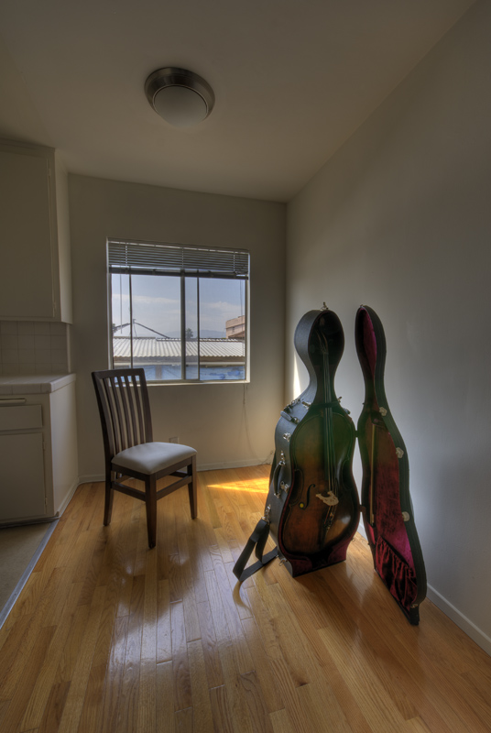
Gamma
This is what Photography people call tonemapping.
Photomatix
This one is local
The one we’ll use is global
Notes:
73
73
73
73
73
73
So what HDR photography does is apply a tonemapping operator. In this case, I used the Photomatix local tonemapping operator. Notice how we can see detail in the sky as well as detail in the cello’s case. The catch is that it tends to destroy the overall lighting balance. We no longer get the sense that window is so much brighter than the inside, and it kinda looks like a painting.

Slide 74
Point of Confusion
Two problems to solve.
Simulate the Iris
Dynamic Range in different shots
Tunnel vs. Daylight
Simulate the Retina
Different Range within a shot
Inside looking outside
Notes:
74
74
74
74
74
74
So this is where everyone gets confused. We need to solve for high dynamic range in different shots, as well as solve for high dynamic range within a single shot.

Slide 75
Terminology
Photography/Film
Within a Shot – HDR Tonemapping
Different Shots – Choosing the correct exposure?
Video Games
Within a Shot – HDR Tonemapping
Different Shots – HDR Tonemapping?
Notes:
75
75
75
75
75
75
In photography, adjusting for high dynamic range in different shots doesn’t really have a name. It’s called choosing the right exposure/aperture/ISO/neutral density filter.
But when they adjust for high dynamic range within a shot, it’s called HDR Tonemapping.

Slide 76
Terminology
For this presentation
Within a Shot – HDR Tonemapping
Different Shots
Automatic Exposure Adjustment
Dynamic Iris
Notes:
76
76
76
76
76
76

Slide 77
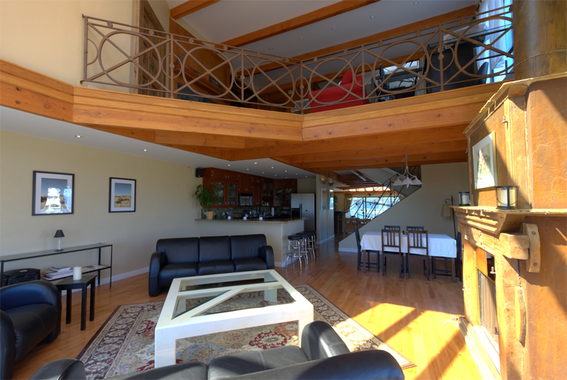
Linear Curve
Apartment of Habib Zargarpour
Creative Director, Microsoft Game Studios
Used to be Art Director on LMNO at EA
Notes:
77
77
77
77
77
77
This is an HDR Image I took from Habib Zargarpour’s condo.

Slide 78
Linear Curve
OutColor = pow(x,1/2.2)‏
Notes:
78
78
78
78
78
78

Slide 79

Reinhard
Most common tonemapping operator is Reinhard
Simplest version is:
F(x) = x/(x+1)
Yes, I’m oversimplifiying for time.
Notes:
79
79
79
79
79
79
Let’s start with linear, and fade-in Reinhard to really look at the difference.

Slide 80
Fade!
Let's fade from linear to Reinhard.
Notes:
80
80
80
80
80
80

Slide 81

Fade!
Let's fade from linear to Reinhard.
Notes:
81
81
81
81
81
81

Slide 82
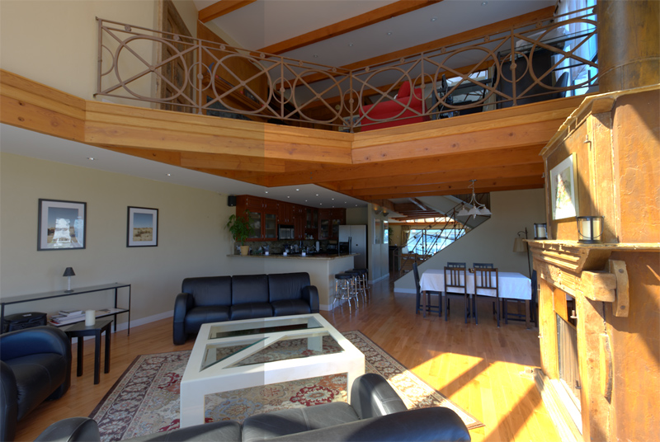
Fade!
Let's fade from linear to Reinhard.
Notes:
82
82
82
82
82
82
One hidden gotcha with Reinhard is that it desaturates your darker areas. It’s almost as if it is adding a thin film in front of the camera.

Slide 83
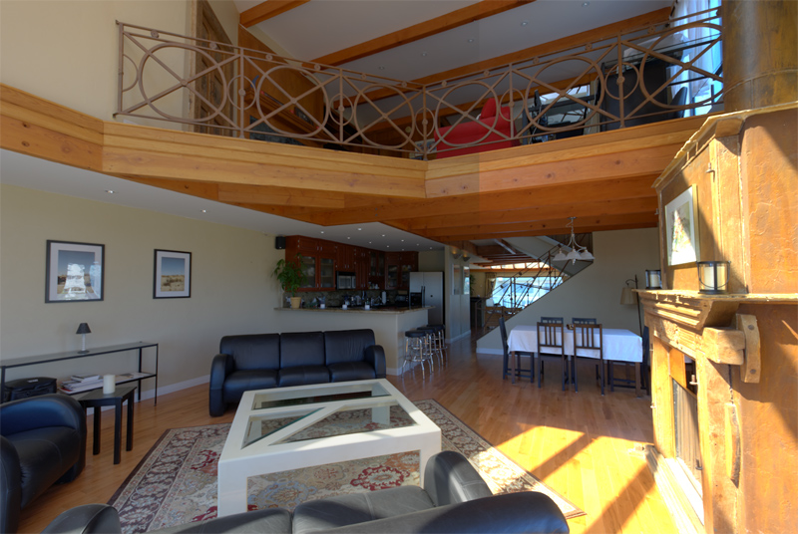
Fade!
Let's fade from linear to Reinhard.
Notes:
83
83
83
83
83
83

Slide 84
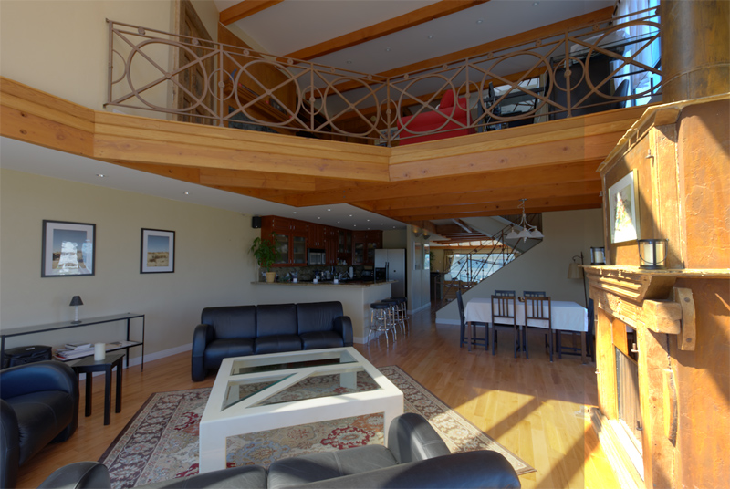
Fade!
Let's fade from linear to Reinhard.
Notes:
84
84
84
84
84
84
And it makes the highlights look better.

Slide 85
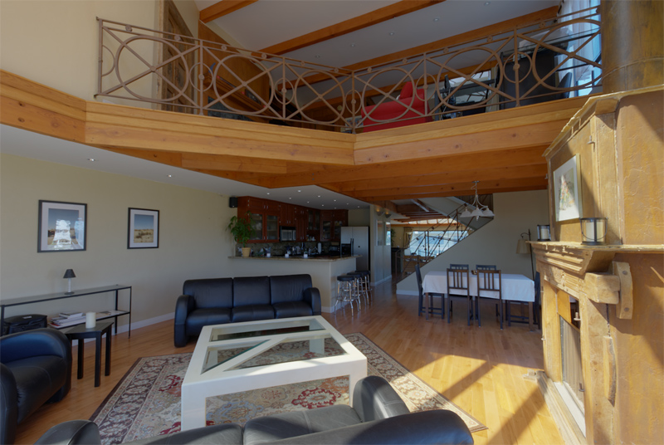
Fade!
Let's fade from linear to Reinhard.
Notes:
85
85
85
85
85
85

Slide 86

Why Does this happen
Start with orange (255,88,21)‏
Notes:
86
86
86
86
86
86

Slide 87


Linear Curve
Linear curve at the low end and high end
Notes:
87
87
87
87
87
87
Low end is fine, but as it goes up, there is some bad hue-shifting as the different channels clamp.

Slide 88
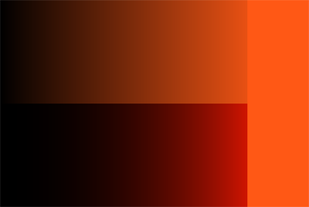

Bad Gamma
Better blacks actually, but wrong color at the bottom and horrible hue-shifting.
Notes:
88
88
88
88
88
88
This is what it looks like if you render without the pow(1/2.2) at the end. You get crisper blacks, but the lower channels really go to black. So orange turns to red because the other channels drop out. At the top end the hue-shifting as color clamps is way worse than pure linear.

Slide 89


Reinhard
Desaturated blacks, but nice top end.
Notes:
89
89
89
89
89
89
And here is Reinhard. Notice how I the low end, it’s much more desaturated. The top end looks nice though, and has a much better fade to white.

Slide 90
Color Changes
Gee...if only we could get:
The crisper, more saturated blacks of improper gamma.
The nice soft highlights of Reinhard
And get the input colors to actually match like pure linear.
Notes:
90
90
90
90
90
90
If only we could get the best of all three…

Slide 91
Voila!
Guess what? There is a solution!
Notes:
91
91
91
91
91
91

Slide 92
Voila!
Solution by Haarm-Peter Duiker
CG Supervisor at Digital Domain
Used to be a CG Supervisor on LMNO at EA
Notes:
92
92
92
92
92
92

Slide 93
Film
Q) Why do they still use film in movies?
A) The look.
Notes:
93
93
93
93
93
93

Slide 94
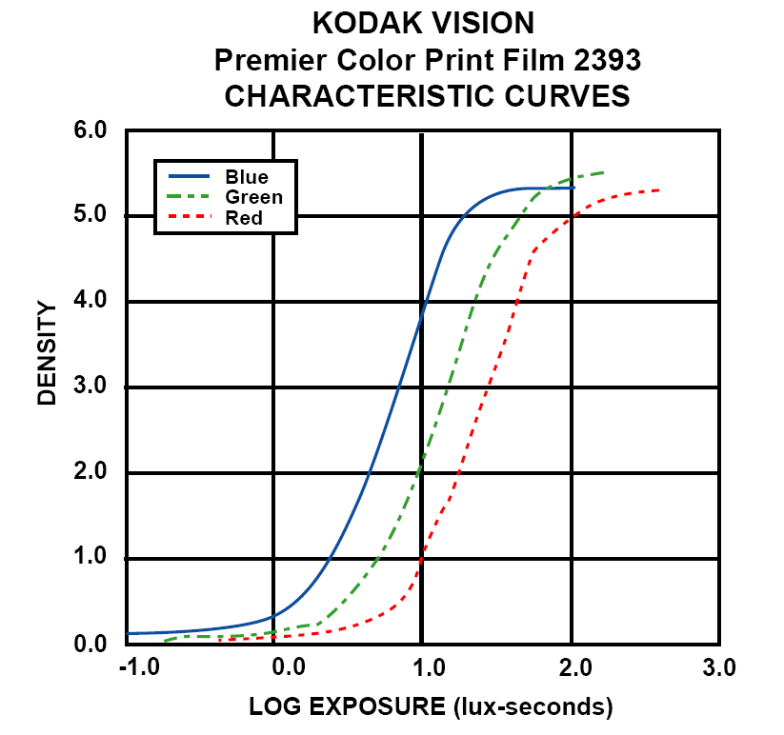
Film
Kodak film examples.
Shoulder
Toe
Notes:
94
94
94
94
94

Slide 95
Film
Using a film curve solves tons of problems.
Film vs. Digital purists.
Who would’ve thought: Kodak knows how to make good film.
Notes:
95
95
95
95
95
95
Here’s why using a film curve is a good thing.

Slide 96
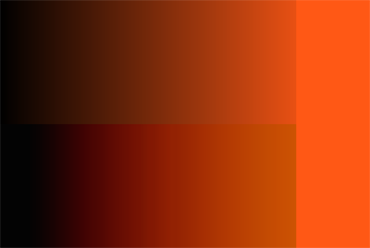

Filmic Curve
Crisp blacks, saturated dark end, and nice highlights.
Notes:
96
96
96
96
96
96
The top is linear and the bottom is an approximation of a film curve. Note how the blacks are crisper and more saturated. And at the top end it fades to white nices.

Slide 97
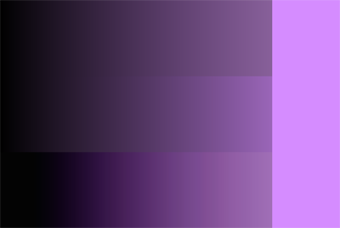
Filmic Tonemapping
This technique works with any color.
Reinhard
Linear
Filmic
Notes:
97
97
97
97
97

Slide 98
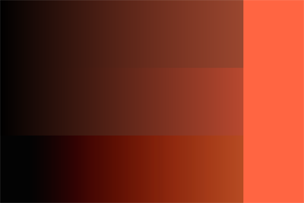
Filmic Tonemapping
This technique works with any color.
Reinhard
Linear
Filmic
Notes:
98
98
98
98
98

Slide 99
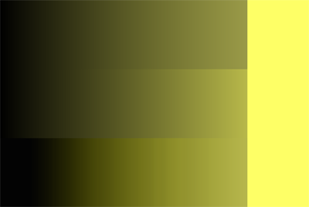
Filmic Tonemapping
This technique works with any color.
Reinhard
Linear
Filmic
Notes:
99
99
99
99
99

Slide 100

Filmic Tonemapping
This technique works with any color.
Reinhard
Linear
Filmic
Notes:
100
100
100
100
100

Slide 101

Filmic Tonemapping
This technique works with any color.
Reinhard
Linear
Filmic
Notes:
101
101
101
101
101

Slide 102

Filmic Tonemapping
This technique works with any color.
Reinhard
Linear
Filmic
Notes:
102
102
102
102
102

Slide 103

Filmic Tonemapping
This technique works with any color.
Reinhard
Linear
Filmic
Notes:
103
103
103
103
103

Slide 104

Filmic Tonemapping
This technique works with any color.
Reinhard
Linear
Filmic
Notes:
104
104
104
104
104

Slide 105

Filmic Tonemapping
This technique works with any color.
Reinhard
Linear
Filmic
Notes:
105
105
105
105
105

Slide 106
Filmic Tonemapping
In terms of “Crisp Blacks” vs. “Milky Blacks”
Filmic > Linear > Reinhard
In terms of “Soft Highights” vs. “Clamped Highlights”
Filmic = Reinhard > Linear
Notes:
106
106
106
106
106

Slide 107
Filmic Tonemapping
Linear.
Notes:
107
107
107
107
107
107
Here is linear.

Slide 108

Filmic Tonemapping
Fade from linear to filmic.
Notes:
108
108
108
108
108
108
Let’s start with linear and fade in to filmic.

Slide 109
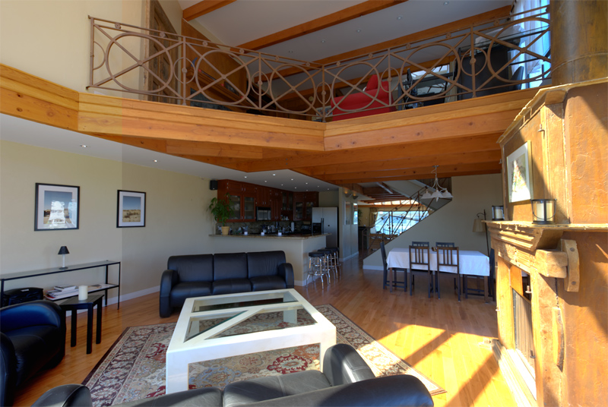
Filmic Tonemapping
Fade from linear to filmic.
Notes:
109
109
109
109
109
109

Slide 110
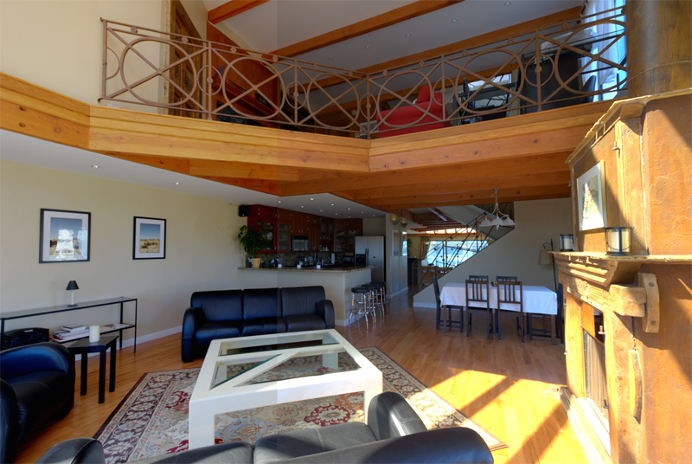
Filmic Tonemapping
Fade from linear to filmic.
Notes:
110
110
110
110
110
110
Notice how it makes the darks better. It essentially removes the gray film.

Slide 111

Filmic Tonemapping
Fade from linear to filmic.
Notes:
111
111
111
111
111
111

Slide 112
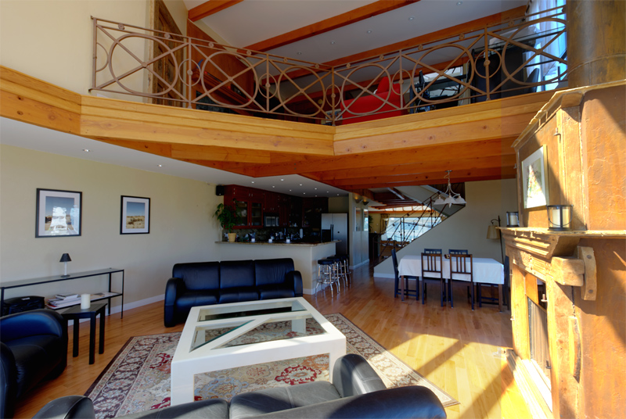
Filmic Tonemapping
Fade from linear to filmic.
Notes:
112
112
112
112
112
112
And you get the softer highlights.

Slide 113
Filmic Tonemapping
Fade from linear to filmic.
Notes:
113
113
113
113
113
113

Slide 114
Filmic vs Reinhard
Fade from linear to Reinhard.
Notes:
114
114
114
114
114
114

Slide 115

Filmic Tonemapping
Fade from Reinhard to filmic.
Notes:
115
115
115
115
115
115
Let’s do the same thing, but now we’ll start with Reinahrd.

Slide 116
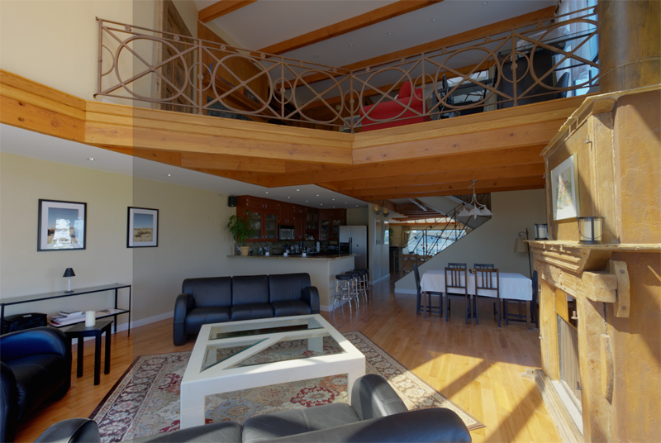
Filmic Tonemapping
Fade from Reinhard to filmic.
Notes:
116
116
116
116
116
116

Slide 117

Filmic Tonemapping
Fade from Reinhard to filmic.
Notes:
117
117
117
117
117
117
Wow, Reinhard is REALLY grayish relative to filmic.

Slide 118

Filmic Tonemapping
Fade from Reinhard to filmic.
Notes:
118
118
118
118
118
118

Slide 119

Filmic Tonemapping
Fade from Reinhard to filmic.
Notes:
119
119
119
119
119
119
The highlights are about the same.

Slide 120
Filmic Tonemapping
Fade from Reinhard to filmic.
Notes:
120
120
120
120
120
120

Slide 121
Filmic Tonemapping
Let's do a comparison.
Notes:
121
121
121
121
121
121

Slide 122

Filmic Tonemapping
This is with a linear curve.
Notes:
122
122
122
122
122
122
Here is a real shot from the game with a linear curve. You can see clamping in their faces. Drake is more tanned and darker than Sully, and they both have specular. So it’s hard to get them both exposed proper while keeping their specular highlights from clamping.

Slide 123

Filmic Tonemapping
And here is filmic.
Notes:
123
123
123
123
123
123
And the filmic curve solves the problem.

Slide 124
Filmic Tonemapping
First, we'll go up.
Notes:
124
124
124
124
124
124
Let’s see what happens as we increase exposure.

Slide 125


Filmic Tonemapping
Exposure 0
Notes:
125
125
125
125
125
125

Slide 126


Filmic Tonemapping
Exposure +1
Notes:
126
126
126
126
126
126

Slide 127


Filmic Tonemapping
Exposure +2
Notes:
127
127
127
127
127
127
The right image is unusable, but the filmic curve still has detail in the highlights as it gets overexposed. Also, there is that white-yellow-red hue-shifting that all Ads know and love.

Slide 128


Filmic Tonemapping
Exposure +3
Notes:
128
128
128
128
128
128

Slide 129


Filmic Tonemapping
Exposure +4
Notes:
129
129
129
129
129
129

Slide 130
Filmic Tonemapping
Ok, now that's bad.
What happens if we go down?
Notice the crisper blacks in the filmic version.
Notes:
130
130
130
130
130
130

Slide 131


Filmic Tonemapping
Exposure: 0
Notes:
131
131
131
131
131
131
This one is a little more subtle, but if you have a good eye, you can see how the darks are crisper in the filmic curve vs. the linear curve. The linear curve looks gray-ish.

Slide 132


Filmic Tonemapping
Exposure: -1
Notes:
132
132
132
132
132
132

Slide 133


Filmic Tonemapping
Exposure: -2
Notes:
133
133
133
133
133
133

Slide 134


Filmic Tonemapping
Exposure: -3
Notes:
134
134
134
134
134
134

Slide 135


Filmic Tonemapping
Exposure: -4
Notes:
135
135
135
135
135
135

Slide 136
Filmic Tonemapping
Colors get crisper and more saturated at the bottom end.
Notes:
136
136
136
136
136
136

Slide 137
Filmic Tonemapping
float3 ld = 0.002;
float linReference = 0.18;
float logReference = 444;
float logGamma = 0.45;
outColor.rgb = (log10(0.4*outColor.rgb/linReference)/ld*logGamma + logReference)/1023.f;
outColor.rgb = clamp(outColor.rgb , 0, 1);
float FilmLutWidth = 256;
float Padding = .5/FilmLutWidth;
outColor.r = tex2D(FilmLutSampler, float2( lerp(Padding,1-Padding,outColor.r), .5)).r;
outColor.g = tex2D(FilmLutSampler, float2( lerp(Padding,1-Padding,outColor.g), .5)).r;
outColor.b = tex2D(FilmLutSampler, float2( lerp(Padding,1-Padding,outColor.b), .5)).r;
Notes:
137
137
137
137
137
137
Here’s the code for reference, but you don’t need to pay attention.

Slide 138
Filmic Tonemapping
Variation in white section:
224
248
254
240
252
Notes:
138
138
138
138
138

Slide 139
More Magic
The catch:
Three texture lookups
Jim Hejl to the rescue
Principle Member of Technical Staff
GPU Group, Office of the CTO
AMD Research
Used to work for EA
Notes:
139
139
139
139
139
139
Jim Hejl created this great approximation of it.

Slide 140
More Magic
Awesome approximation with only ALU ops.
Replaces the entire Lin/Log and Texture LUT
Includes the pow(x,1/2.2)‏
x = max(0, LinearColor-0.004);
GammaColor = (x*(6.2*x+0.5))/(x*(6.2*x+1.7)+0.06);
Notes:
140
140
140
140
140

Slide 141
Filmic Tonemapping
Nice curve
Toe arguably too strong
Most monitors are too contrasty, strong toe makes it worse
May want less shoulder
The more range, the more shoulder
If your scene lacks range, you want to tone down the shoulder a bit
Notes:
141
141
141
141
141
141
Their curve is great on a perfectly calibrated monitor with real lighting. But most monitors are too contrasty, so you might want to reduce the toe a bit. Also, if you don’t have as much range as the real world, you don’t need as strong of a shoulder. So I tweaked their formula and created a version which lets the artists tweak the parameters a bit.

Slide 142
Filmic Tonemapping
A = Shoulder Strength
B = Linear Strength
C = Linear Angle
D = Toe Strength
E = Toe Numerator
F = Toe Denominator
Note: E/F = Toe Angle
LinearWhite = Linear White Point Value
F(x) = ((x*(A*x+C*B)+D*E)/(x*(A*x+B)+D*F)) - E/F;
FinalColor = F(LinearColor)/F(LinearWhite)‏
Notes:
142
142
142
142
142
142

Slide 143
Filmic Tonemapping
Shoulder Strength = 0.22
Linear Strength = 0.30
Linear Angle = 0.10
Toe Strength = 0.20
Toe Numerator = 0.01
Toe Denominator = 0.30
Linear White Point Value = 11.2
These numbers DO NOT have the pow(x,1/2.2) baked in
Notes:
143
143
143
143
143
143
I’ll let you play with the numbers on your own. These are our defaults.

Slide 144
Conclusions
Filmic Tonemapping
IMO: The most important post effect
Changes your life completely
Once you have it, you can't live without it
If you implement it, you have to redo all your lighting
You can't just switch it on if your lighting is tweaked for no dynamic range.
Notes:
144
144
144
144
144
144

Slide 145

Filmic Tonemapping
“At least I’m not getting choked in gamma space...”
Notes:
145
145
145
145
145
145
Ok, so filmic tonemapping. First, let’s talk about the human eye.

Slide 146

Part 3: SSAO
Notes:
146
146
146
146
146
146

Slide 147
SSAO Time
That was fun.
Time for stage 3.
Let’s talk about why you need AO.
Notes:
147
147
147
147
147
147
Why do you need AO?

Slide 148

Why AO?
The shadow “grounds” the car.
Notes:
148
148
148
148
148
148
Artists always talk about using the shadow of the sun to make the objects seem like they are attached to the ground.

Slide 149

Why AO?
Unless you’re already in the shadow!
Notes:
149
149
149
149
149
149
But what if you are in the sunlight shadow already? That car seems like it’s attached to the ground, but not because of the sunlight shadow. It’s ambient occlusion!

Slide 150

Why AO?
Your shadow can't help you now!
Notes:
150
150
150
150
150
150

Slide 151

Why AO?
Your shadow can't help you now!
Notes:
151
151
151
151
151
151

Slide 152

Why AO?
Your shadow can't help you now!
Notes:
152
152
152
152
152
152
The same thing happens on characters. Notice the darkness around the feet.

Slide 153

Why AO?
Your shadow can't help you now!
Notes:
153
153
153
153
153
153

Slide 154
How important is it?
The shadow from the sun grounds object.
But if you are already in shadow, you need something else...
It's the AO that grounds the car in those shots.
So what if we took the AO out?
Trick taught to me by Habib (the guy with the awesome condo earlier)‏
Notes:
154
154
154
154
154
154
Let’s get out the clone-stamp in photoshop and try to make these real shots look like a video game.

Slide 155
Why AO?
Your shadow can't help you now!
Notes:
155
155
155
155
155
155

Slide 156

Why AO?
Your shadow can't help you now!
Notes:
156
156
156
156
156
156

Slide 157
Why AO?
Your shadow can't help you now!
Notes:
157
157
157
157
157
157

Slide 158

Why AO?
Your shadow can't help you now!
Notes:
158
158
158
158
158
158

Slide 159
Why AO?
Your shadow can't help you now!
Notes:
159
159
159
159
159
159
If you take out the AO, it looks like the character doesn’t belong there, as if he was poorly photoshopped in.

Slide 160

Why AO?
Your shadow can't help you now!
Notes:
160
160
160
160
160
160
It looks like a video game!

Slide 161
Why AO?
Your shadow can't help you now!
Notes:
161
161
161
161
161
161

Slide 162

Why AO?
Your shadow can't help you now!
Notes:
162
162
162
162
162
162

Slide 163

How to use AO?
Sun is Directional Light
Sky is Hemisphere Light (ish)‏
Notes:
163
163
163
163
163
163
As we all know the sun is a yellowish direcitonal light, and the sky is a bluish hemispherical light.

Slide 164

How to use AO?
Sun is Yellow (ish)‏
Sky is Blue (ish)‏
Notes:
164
164
164
164
164
164

Slide 165

How to use AO?
Sun is Directional
Approximate Directional Shadow with Shadow Mapping
Notes:
165
165
165
165
165
165
The way to simulate a directional light is shadow mapping.

Slide 166

How to use AO?
Sky is Hemisphere (sorta)‏
Approximate Hemisphere Shadow with AO
Notes:
166
166
166
166
166
166
And the way to simulate a hemispherical shadow is AO.

Slide 167



How to use AO?
Sun is yellow, sky is blue.
Notes:
167
167
167
167
167
167

Slide 168

How to use AO?
Notes:
168
168
168
168
168
168
So the area in the shadow has the blue sky color, but has the yellow sunlight blocked, so it looks blue.

Slide 169

How to use AO?
Notes:
169
169
169
169
169
169
But under the car, deep inside the AO and the shadow, almost no light gets in, so it’s basically black.

Slide 170

How to use AO?
Notes:
170
170
170
170
170
170
Well away from the car, there is no shadow and no AO. It gets the yellowish sunlight and the bluish skylight so it looks grey.

Slide 171

How to use AO?
Notes:
171
171
171
171
171
171
And while in direct sunlight but still in AO, we get yellow from the sun, but no blue from the sky, so it looks yellowish.

Slide 172

How to use AO?
Notes:
172
172
172
172
172
172

Slide 173
Sunlight
Q) Why not have it affect sunlight?
A) It does the exact opposite of what you want it to do.
Notes:
173
173
173
173
173
173
So to be correct, AO should clearly not affect the sunlight areas. But artistically?

Slide 174

SSAO Example
Off
Notes:
174
174
174
174
174
174

Slide 175
SSAO Example
On
Notes:
175
175
175
175
175
175
Turning on AO in ambient perceptual reduces the intensity of the shadows, which is good.

Slide 176
SSAO Example
SSAO Darkens Shadows – Good
SSAO Darkens Sunlight – BAD
Reduces perceived contrast
Makes lighting look flatter
My Opinion: SSAO should NOT affect Direct Light
Notes:
176
176
176
176
176
176
One of our major goals in games is to make the sunlight areas seem perceptually brighter than the shadowed areas. If we apply AO to the sunlight, it brings the sunlight areas down and actually reduces the contrast in the scene. The same thing happens when your diffuse textures have too much black in them.

Slide 177
The Algorithm
Only Input is Half-Res Depth
No normals
No special filtering (I.e. Bilateral)‏
Processed in 64x64 blocks
Adjacent Depth tiles included as well
Notes:
177
177
177
177
177
177
So getting to the actual tech.

Slide 178
The Algorithm
Calculate Base AO
Dilate Horizontal
Dilate Vertical
Apply Low Pass Filter
Notes:
178
178
178
178
178
178

Slide 179

SSAO Passes
0) Base Image
Notes:
179
179
179
179
179
179

Slide 180

SSAO Passes
1) Base SSAO
Notes:
180
180
180
180
180
180

Slide 181

SSAO Passes
2) Dilate Horizontal
Notes:
181
181
181
181
181
181

Slide 182

SSAO Passes
3) Dilate Vertical
Notes:
182
182
182
182
182
182

Slide 183

SSAO Passes
4) Low Pass Filter
(I.e. blur the $&%@ out of it)‏
Notes:
183
183
183
183
183
183

Slide 184
SSAO Passes
Step One: The Base AO
Uses half-res depth buffer
Calculate AO based on nearby depth samples
Notes:
184
184
184
184
184
184

Slide 185

SSAO Passes
Pink point on a black surface.
Notes:
185
185
185
185
185
185

Slide 186

SSAO Passes
Correct way is to look at the hemisphere...
Notes:
186
186
186
186
186
186

Slide 187

SSAO Passes
...and find the area that is visible to the point.
Our solution is much hackier.
Notes:
187
187
187
187
187
187

Slide 188

SSAO Passes
Who needs sphere? A box will do just as well.
Notes:
188
188
188
188
188
188
SSAO is such a hack anyway that using an approach with volume is just as good as surface area of a hemisphere.

Slide 189

SSAO Passes
Instead of area though, we will approximate volume.
Notes:
189
189
189
189
189
189

Slide 190

SSAO Passes
We can estimate volume without knowing the normal.
Half Volume = Fully Unoccluded
Notes:
190
190
190
190
190
190

Slide 191

SSAO Passes
We can estimate volume without knowing the normal.
Half Volume = Fully Unoccluded
Notes:
191
191
191
191
191
191

Slide 192

SSAO Passes
We can estimate volume without knowing the normal.
Half Volume = Fully Unoccluded
Notes:
192
192
192
192
192
192

Slide 193

SSAO Passes
We can estimate volume without knowing the normal.
Half Volume = Fully Unoccluded
Notes:
193
193
193
193
193
193

Slide 194

SSAO Passes
Start with a point
Notes:
194
194
194
194
194
194

Slide 195

SSAO Passes
And sample pairs of points.
Notes:
195
195
195
195
195
195
The trick is to take pairs of points, and sample depths to estimate whether the curve is concave or convex. And if so, how much.

Slide 196

SSAO Passes
What if we have an occluder?
Notes:
196
196
196
196
196
196
But if we have a depth discontinuity, then we don’t have any info, so we have to discard the pair of samples.

Slide 197

SSAO Passes
What if we have an occluder?
Notes:
197
197
197
197
197
197

Slide 198

SSAO Passes
We lose depth info.
Notes:
198
198
198
198
198
198

Slide 199

SSAO Passes
We could call it occluded.
Notes:
199
199
199
199
199
199

Slide 200

SSAO Passes
But, is that correct? Maybe not.
Notes:
200
200
200
200
200
200

Slide 201

SSAO Passes
Let's choose a cutoff, and mark the pair as invalid.
Notes:
201
201
201
201
201
201

Slide 202

SSAO Passes
Sample pattern?
Notes:
202
202
202
202
202
202
Here’s our sample pattern.

Slide 203

SSAO Passes
Sample pattern. Discard in pairs.
Notes:
203
203
203
203
203
203
In retrospect, I wish we had diagonal samples, but you usually can’t notice it. There are times when I miss it though.

Slide 204

SSAO Passes
Note the single light outline.
Notes:
204
204
204
204
204
204
We get this one pixel line, which we clean up with a dilate in the cavities of the depth buffer.

Slide 205

SSAO Passes
Find discontinuties...
Notes:
205
205
205
205
205
205

Slide 206

SSAO Passes
Find discontinuties...
Notes:
206
206
206
206
206
206

Slide 207

SSAO Passes
Find discontinuties...
Notes:
207
207
207
207
207
207

Slide 208

SSAO Passes
Find discontinuties...
Notes:
208
208
208
208
208
208

Slide 209
SSAO Passes
...and dilate at discontinuties. Here is original.
Notes:
209
209
209
209
209
209

Slide 210

SSAO Passes
After X dilate.
Notes:
210
210
210
210
210
210

Slide 211

SSAO Passes
After Y dilate. And the light outline is gone.
Notes:
211
211
211
211
211
211

Slide 212

SSAO Passes
And do a gaussian blur.
Notes:
212
212
212
212
212
212

Slide 213
SSAO Passes
Final
Notes:
213
213
213
213
213
213

Slide 214
Artifacts
White Outline
Crossing Pattern
Depth Discontinuities
Notes:
214
214
214
214
214
214

Slide 215
Artifacts
Blur adds white outline
Crossing Pattern
Notes:
215
215
215
215
215
215
Unfortunately the blur adds a perceptual light halo around objects. We also get that cross pattern to the bottom-left of his feet.

Slide 216

Artifacts
More Crossing patterns
Notes:
216
216
216
216
216
216
This effect actually happens everywhere in the game, but you usually don’t notice. One place you can see it is next to the beer bottles by the bar in the Flynn intro. You can also see it on the bedpost next to the wall during the Chloe intro in Drake’s hotel room.

Slide 217

Artifacts
Depth Discontinuities. Notice a little anti-halo.
Notes:
217
217
217
217
217
217

Slide 218

Artifacts
Hard to see in real levels though.
Notes:
218
218
218
218
218
218
Uncharted 2 is a very visually noisy game, which hides a lot of artifacts in the SSAO.

Slide 219
Artifacts
Artifacts are usually only noticeable to the trained eye
Benefits outweigh drawbacks
Have option to turn it off per surface
Most snow fades at distance
Some objects apply sqrt() to brighten it
Some objects just have it off
Notes:
219
219
219
219
219
219

Slide 220

More Shots
On
Notes:
220
220
220
220
220
220

Slide 221

More Shots
Off
Notes:
221
221
221
221
221
221

Slide 222

More Shots
Here's a few more shots.
Notes:
222
222
222
222
222
222

Slide 223

More Shots
Here's a few more shots.
Notes:
223
223
223
223
223
223

Slide 224

More Shots
Here's a few more shots.
Notes:
224
224
224
224
224
224

Slide 225

More Shots
Here's a few more shots.
Notes:
225
225
225
225
225
225

Slide 226

More Shots
Here's a few more shots.
Notes:
226
226
226
226
226
226

Slide 227

More Shots
Here's a few more shots.
Notes:
227
227
227
227
227
227

Slide 228

More Shots
Here's a few more shots.
Notes:
228
228
228
228
228
228

Slide 229

More Shots
Here's a few more shots.
Notes:
229
229
229
229
229
229

Slide 230

More Shots
Here's a few more shots.
Notes:
230
230
230
230
230
230

Slide 231

More Shots
Here's a few more shots.
Notes:
231
231
231
231
231
231

Slide 232
SSAO Conclusion
Grounds characters and other objects
Deepens our Blacks
Artifacts are not too bad
Could use better filtering for halos
Runs on SPUs, and doesn’t need normal buffer
Notes:
232
232
232
232
232
232
Thought you could use a little rendering architecture knowledge, so here goes. I’m leaving a lot out here.

Slide 233

Part 4: Architecture
Notes:
233
233
233
233
233
233

Slide 234
Architecture
Time for part 4.
Here is the base overview.
Skip some things
Notes:
234
234
234
234
234
234
Thought you could use a little rendering architecture knowledge, so here goes. I’m leaving a lot out here.

Slide 235

Rendering Passes
Final output
Notes:
235
235
235
235
235
235

Slide 236


Rendering Passes
Depth and Normal, 2x MSAA
Notes:
236
236
236
236
236
236

Slide 237

Rendering Passes
Shadow depths for cascades
Notes:
237
237
237
237
237
237

Slide 238

Rendering Passes
Cascade calculation to screen-space
Notes:
238
238
238
238
238
238

Slide 239
Rendering Passes
Meanwhile on the SPUs...
Notes:
239
239
239
239
239
239
While the GPU is calculating shadows, the SPUs are hard at work…

Slide 240

Rendering Passes
SSAO
Notes:
240
240
240
240
240
240

Slide 241

Rendering Passes
Fullscreen lighting. Diffuse and specular.
Calculate lighting in Tiles
Notes:
241
241
241
241
241
241

Slide 242
Rendering Passes
Back on the GPU...
Notes:
242
242
242
242
242
242

Slide 243

Rendering Passes
Render to RGBM, 2x MSAA
Notes:
243
243
243
243
243
243

Slide 244

Rendering Passes
Resolve RGBM 2x MSAA to FP16 1x
Notes:
244
244
244
244
244
244

Slide 245
Rendering Passes
Transparent objects and post.
Notes:
245
245
245
245
245
245

Slide 246

Full Timeline
Full Rendering Pipeline
Notes:
246
246
246
246
246
246

Slide 247

Full Timeline
Full Render in 3 frames
Notes:
247
247
247
247
247
247

Slide 248

Frame 1
Begin Frame 1.
Notes:
248
248
248
248
248
248

Slide 249
Frame 1
Timeline
SPUs
GPU
PPU
Notes:
249
249
249
249
249
249

Slide 250
Frame 1
Begin Frame 1.
Notes:
250
250
250
250
250
250

Slide 251

Frame 1
All PPU stuff.
Notes:
251
251
251
251
251
251

Slide 252

Frame 1
PPU kicks off SPU jobs
Notes:
252
252
252
252
252
252

Slide 253
Frame 2
Does most of the rendering.
Notes:
253
253
253
253
253
253

Slide 254

Frame 2
Vertex processing on SPUs...
Notes:
254
254
254
254
254
254

Slide 255

Frame 2
...kicks of 2x DepthNormal pass.
Notes:
255
255
255
255
255
255

Slide 256

Frame 2
Resolve 2x MSAA buffers to 1x and copy.
Notes:
256
256
256
256
256
256

Slide 257

Frame 2
Spotlight shadow depth pass.
Notes:
257
257
257
257
257
257

Slide 258

Frame 2
Sunlight shadow depth pass.
Notes:
258
258
258
258
258
258

Slide 259

Frame 2
Kick Fullscreen Lighting SPU jobs.
Notes:
259
259
259
259
259
259

Slide 260

Frame 2
SSAO Jobs.
Notes:
260
260
260
260
260
260

Slide 261

Frame 2
Motion Blur
Notes:
261
261
261
261
261
261

Slide 262

Frame 2
Resolve shadow to screen. Copy Fullscreen lighting.
Notes:
262
262
262
262
262
262

Slide 263

Frame 2
Add Fullscreen shadowed lights.
Notes:
263
263
263
263
263
263

Slide 264

Frame 2
Standard Pass Vertex Processing on SPUs.
Notes:
264
264
264
264
264
264

Slide 265

Frame 2
Standard pass. Writes to 2x RGBM.
Notes:
265
265
265
265
265
265

Slide 266

Frame 2
Resolve 2x RGBM to 1x FP16
Notes:
266
266
266
266
266
266

Slide 267

Frame 2
Full-Res Alpha-Blended effects.
Notes:
267
267
267
267
267
267

Slide 268

Frame 2
Half-Res Particles and Composite.
Notes:
268
268
268
268
268
268

Slide 269
Frame 3
Now for the 3rd frame.
Notes:
269
269
269
269
269
269

Slide 270

Frame 3
Start PostFX jobs at end of Frame 2.
Notes:
270
270
270
270
270
270

Slide 271

Frame 3
Fill in PostFX jobs in Frame 3 with low priority.
Notes:
271
271
271
271
271
271

Slide 272

Frame 3
Read from main memory, do distortion and HUD.
Notes:
272
272
272
272
272
272

Slide 273

Full Timeline
All together.
Notes:
273
273
273
273
273
273

Slide 274
SPU Optimization
Quick notes on how we optimize SPU code.
Notes:
274
274
274
274
274
274

Slide 275
Performance
Yes! You can optimize SPU code by hand!
This was news to me when I started here.
Notes:
275
275
275
275
275
275

Slide 276
Performance
Let’s talk about Laundry
Say you have 5 loads to do
1 washer, 1 dryer
Notes:
276
276
276
276
276
276

Slide 277
In-Order
Load 1 in Washer
Load 1 in Dryer
Load 2 in Washer
Load 2 in Dryer
Load 3 in Washer
Load 3 in Dryer
Load 4 in Washer
Load 4 in Dryer
Load 5 in Washer
Load 5 in Dryer
Notes:
277
277
277
277
277
277

Slide 278
Pipelined
Load 1 in Washer
Load 2 in Washer, Load 1 in Dryer
Load 3 in Washer, Load 2 in Dryer
Load 4 in Washer, Load 3 in Dryer
Load 5 in Washer, Load 4 in Dryer
Load 5 in Dryer
Notes:
278
278
278
278
278
278

Slide 279
Software Pipelining
We can do this in software
Called “Software Pipelining”
It’s how we optimize SPU code by hand
Pal Engstad (our Lead Graphics Programmer) will be putting a doc online explaining the full process.
Should be online: look for the post on the blog
Direct links:
www.naughtydog.com/docs/gdc2010/intro-spu-optimizations-part-1.pdf
www.naughtydog.com/docs/gdc2010/intro-spu-optimizations-part-2.pdf
Notes:
279
279
279
279
279
279

Slide 280
SPU C++ Intrinsics
for( int y = 0; y < clampHeight; y++ ) {
int lColorOffset = y * kAoBufferLineWidth;
VF32 currWordAo = pvColor[ lColorOffset / 4 ];
prevWordAo[0] = prevWordAo[1] = prevWordAo[2] = prevWordAo[3] = currWordAo[0];
ao_n4 = prevWordAo;
ao_n3 = (VF32)si_shufb( (qword)prevWordAo, (qword)currWordAo, (qword)s_BCDa );
ao_n2 = (VF32)si_shufb( (qword)prevWordAo, (qword)currWordAo, (qword)s_CDab );
ao_n1 = (VF32)si_shufb( (qword)prevWordAo, (qword)currWordAo, (qword)s_Dabc );
ao_curr = currWordAo;
for (int x = 0; x < kAoBufferLineWidth; x+=4) {
VF32 nextWordAo = pvColor[ (lColorOffset + x + 4)/ 4 ];
VF32 ao_p1 = (VF32)si_shufb( (qword)currWordAo, (qword)nextWordAo, (qword)s_BCDa );
VF32 ao_p2 = (VF32)si_shufb( (qword)currWordAo, (qword)nextWordAo, (qword)s_CDab );
VF32 ao_p3 = (VF32)si_shufb( (qword)currWordAo, (qword)nextWordAo, (qword)s_Dabc );
VF32 ao_p4 = nextWordAo;
VF32 blurAo = ao_n4*w4 + ao_n3*w3 + ao_n2*w2 + ao_n1*w1 + ao_curr*w0;
blurAo += ao_p1*w1 + ao_p2*w2 + ao_p3*w3 + ao_p4*w4;
pvColor[ (lColorOffset + x)/ 4 ] = blurAo;
prevWordAo = currWordAo;
currWordAo = nextWordAo;
ao_n4 = prevWordAo;
ao_n3 = ao_p1;
ao_n2 = ao_p2;
ao_n1 = ao_p3;
ao_curr = currWordAo;
}
}
Notes:
280
280
280
280
280

Slide 281
SPU Assembly 1/2
EVEN
ODD
loop:
{nop} {o6} lqx currAo, pvColor, colorOffset
{nop} {o4} shufb prevAo0, currAo, currAo, s_AAAA
{nop} {o4} shufb ao_n30, prevAo0, currAo, s_BCDa
{nop} {o4} shufb ao_n20, prevAo0, currAo, s_CDab
{nop} {o4} shufb ao_n10, prevAo0, currAo, s_Dabc
{e2} selb ao_n4, ao_n4, prevAo0, endLineMask {lnop}
{e2} selb ao_n3, ao_n3, ao_n30, endLineMask {lnop}
{e2} selb ao_n2, ao_n2, ao_n20, endLineMask {lnop}
{e2} selb ao_n1, ao_n1, ao_n10, endLineMask {lnop}
{nop} {o6} lqx nextAo, pvNextColor, colorOffset
{nop} {o4} shufb ao_p1, currAo, nextAo, s_BCDa
{nop} {o4} shufb ao_p2, currAo, nextAo, s_CDab
{nop} {o4} shufb ao_p3, currAo, nextAo, s_Dabc
{e6} fa ao_n4, ao_n4, nextAo {lnop}
{e6} fa ao_n3, ao_n3, ao_p3 {lnop}
{e6} fa ao_n2, ao_n2, ao_p2 {lnop}
{e6} fa ao_n1, ao_n1, ao_p1 {lnop}
Notes:
281
281
281
281
281

Slide 282
SPU Assembly 2/2
EVEN
ODD
{e6} fm blurAo, ao_n4, w4 {lnop}
{e6} fma blurAo, ao_n3, w3, blurAo {lnop}
{e6} fma blurAo, ao_n2, w2, blurAo {lnop}
{e6} fma blurAo, ao_n1, w1, blurAo {lnop}
{e6} fma blurAo, currAo, w0, blurAo {lnop}
{nop} {o6} stqx blurAo, pvColor, colorOffset
{nop} {o4} shlqbii ao_n4, currAo, 0
{nop} {o4} shlqbii ao_n3, ao_p1, 0
{nop} {o4} shlqbii ao_n2, ao_p2, 0
{nop} {o4} shlqbii ao_n1, ao_p3, 0
{e2} ceq endLineMask, colorOffset, endLineOffset {lnop}
{e2} ceq endBlockMask, colorOffset, endOffset {lnop}
{e2} selb endLineOffsetIncr, zero, colorLineBytes, endLineMask {lnop}
{e2} selb colorOffsetIncr, defOffsetIncr, endColorOffsetIncr, endLineMask {lnop}
{e2} a endLineOffset, endLineOffset, endLineOffsetIncr {lnop}
{e2} a colorOffset, colorOffset, colorOffsetIncr {lnop}
{nop} branch: {o?} brz endBlockMask, loop
Notes:
282
282
282
282
282

Slide 283
SPU Assembly
{e6} fa ao_n3, ao_n3, ao_p3 {o6} lqx nextAo, pvNextColor, colorOffset
Here is a sample line of assembly code
SPUs issue one even and odd instruction per cycle
One line = One cycle
e6 = even, 6 cycle latency
o6 = odd, 6 cycle latency
Notes:
283
283
283
283
283

Slide 284
Iteration 1
loop:
nop lnop
nop lnop
nop lnop
nop lnop
nop lnop
nop lnop
nop lnop
nop lnop
nop lnop
nop lnop
nop lnop
nop lnop
nop lnop
nop lnop
nop lnop
nop lnop
nop lnop
nop lnop
nop lnop
nop branch: {o?:0} brz endBlockMask, loop
Notes:
284
284
284
284
284

Slide 285
Iteration 1
loop:
nop lnop
nop {o6:0} lqx currAo, pvColor, colorOffset
nop {o6:0} lqx nextAo, pvNextColor, colorOffset
nop {o4:0} shlqbii endLineMask_, endLineMask, 0
nop lnop
nop lnop
nop lnop
nop {o4:0} shufb prevAo0, currAo, currAo, s_AAAA
{e2:0} ceq endLineMask, colorOffset, endLineOffset {o4:0} shufb ao_p1, currAo, nextAo, s_BCDa
{e2:0} ceq endBlockMask, colorOffset_, endOffset {o4:0} shufb ao_p2, currAo, nextAo, s_CDab
{e2:0} selb endLineOffsetIncr, zero, colorLineBytes, endLineMask {o4:0} shufb ao_p3, currAo, nextAo, s_Dabc
{e2:0} selb ao_n4, currAo_, prevAo0, endLineMask_ {o4:0} shufb ao_n30, prevAo0, currAo, s_BCDa
nop {o4:0} shufb ao_n20, prevAo0, currAo, s_CDab
nop {o4:0} shufb ao_n10, prevAo0, currAo, s_Dabc
{e2:0} selb colorOffsetIncr, defOffsetIncr, endColorOffsetIncr, endLineMask lnop
{e2:0} selb ao_n3, ao_p1_, ao_n30, endLineMask_ {o4:0} shufb colorOffset_, colorOffset_, colorOffset, s_BCa0
{e2:0} selb ao_n2, ao_p2_, ao_n20, endLineMask_ lnop
{e2:0} selb ao_n1, ao_p3_, ao_n10, endLineMask_ lnop
{e2:0} a colorOffset, colorOffset, colorOffsetIncr lnop
{e2:0} a endLineOffset, endLineOffset, endLineOffsetIncr branch: {o?:0} brz endBlockMask, loop
Notes:
285
285
285
285
285

Slide 286
Iteration 1
loop:
nop lnop
nop {o6:0} lqx currAo, pvColor, colorOffset
nop {o6:0} lqx nextAo, pvNextColor, colorOffset
nop {o4:0} shlqbii endLineMask_, endLineMask, 0
nop lnop
nop lnop
nop lnop
nop {o4:0} shufb prevAo0, currAo, currAo, s_AAAA
{e2:0} ceq endLineMask, colorOffset, endLineOffset {o4:0} shufb ao_p1, currAo, nextAo, s_BCDa
{e2:0} ceq endBlockMask, colorOffset_, endOffset {o4:0} shufb ao_p2, currAo, nextAo, s_CDab
{e2:0} selb endLineOffsetIncr, zero, colorLineBytes, endLineMask {o4:0} shufb ao_p3, currAo, nextAo, s_Dabc
{e2:0} selb ao_n4, currAo_, prevAo0, endLineMask_ {o4:0} shufb ao_n30, prevAo0, currAo, s_BCDa
nop {o4:0} shufb ao_n20, prevAo0, currAo, s_CDab
nop {o4:0} shufb ao_n10, prevAo0, currAo, s_Dabc
{e2:0} selb colorOffsetIncr, defOffsetIncr, endColorOffsetIncr, endLineMask lnop
{e2:0} selb ao_n3, ao_p1_, ao_n30, endLineMask_ {o4:0} shufb colorOffset_, colorOffset_, colorOffset, s_BCa0
{e2:0} selb ao_n2, ao_p2_, ao_n20, endLineMask_ lnop
{e2:0} selb ao_n1, ao_p3_, ao_n10, endLineMask_ lnop
{e2:0} a colorOffset, colorOffset, colorOffsetIncr lnop
{e2:0} a endLineOffset, endLineOffset, endLineOffsetIncr branch: {o?:0} brz endBlockMask, loop
Notes:
286
286
286
286
286

Slide 287
Problems
Take this line:
{o6} lqx currAo, pvColor, colorOffset
{o4} shufb prevAo0, currAo, currAo, s_AAAA
Load a value into currAo
Next instruction needs currAo
currAo won’t be ready yet
Stall for 5 cycles
Notes:
287
287
287
287
287

Slide 288
Iteration 1
loop:
nop lnop
nop {o6:0} lqx currAo, pvColor, colorOffset
nop {o6:0} lqx nextAo, pvNextColor, colorOffset
nop {o4:0} shlqbii endLineMask_, endLineMask, 0
nop lnop
nop lnop
nop lnop
nop {o4:0} shufb prevAo0, currAo, currAo, s_AAAA
{e2:0} ceq endLineMask, colorOffset, endLineOffset {o4:0} shufb ao_p1, currAo, nextAo, s_BCDa
{e2:0} ceq endBlockMask, colorOffset_, endOffset {o4:0} shufb ao_p2, currAo, nextAo, s_CDab
{e2:0} selb endLineOffsetIncr, zero, colorLineBytes, endLineMask {o4:0} shufb ao_p3, currAo, nextAo, s_Dabc
{e2:0} selb ao_n4, currAo_, prevAo0, endLineMask_ {o4:0} shufb ao_n30, prevAo0, currAo, s_BCDa
nop {o4:0} shufb ao_n20, prevAo0, currAo, s_CDab
nop {o4:0} shufb ao_n10, prevAo0, currAo, s_Dabc
{e2:0} selb colorOffsetIncr, defOffsetIncr, endColorOffsetIncr, endLineMask lnop
{e2:0} selb ao_n3, ao_p1_, ao_n30, endLineMask_ {o4:0} shufb colorOffset_, colorOffset_, colorOffset, s_BCa0
{e2:0} selb ao_n2, ao_p2_, ao_n20, endLineMask_ lnop
{e2:0} selb ao_n1, ao_p3_, ao_n10, endLineMask_ lnop
{e2:0} a colorOffset, colorOffset, colorOffsetIncr lnop
{e2:0} a endLineOffset, endLineOffset, endLineOffsetIncr branch: {o?:0} brz endBlockMask, loop
Notes:
288
288
288
288
288

Slide 289
Iteration 1
loop:
nop lnop
nop {o6:0} lqx currAo, pvColor, colorOffset
nop {o6:0} lqx nextAo, pvNextColor, colorOffset
nop {o4:0} shlqbii endLineMask_, endLineMask, 0
nop lnop
nop lnop
nop lnop
nop {o4:0} shufb prevAo0, currAo, currAo, s_AAAA
{e2:0} ceq endLineMask, colorOffset, endLineOffset {o4:0} shufb ao_p1, currAo, nextAo, s_BCDa
{e2:0} ceq endBlockMask, colorOffset_, endOffset {o4:0} shufb ao_p2, currAo, nextAo, s_CDab
{e2:0} selb endLineOffsetIncr, zero, colorLineBytes, endLineMask {o4:0} shufb ao_p3, currAo, nextAo, s_Dabc
{e2:0} selb ao_n4, currAo_, prevAo0, endLineMask_ {o4:0} shufb ao_n30, prevAo0, currAo, s_BCDa
nop {o4:0} shufb ao_n20, prevAo0, currAo, s_CDab
nop {o4:0} shufb ao_n10, prevAo0, currAo, s_Dabc
{e2:0} selb colorOffsetIncr, defOffsetIncr, endColorOffsetIncr, endLineMask lnop
{e2:0} selb ao_n3, ao_p1_, ao_n30, endLineMask_ {o4:0} shufb colorOffset_, colorOffset_, colorOffset, s_BCa0
{e2:0} selb ao_n2, ao_p2_, ao_n20, endLineMask_ lnop
{e2:0} selb ao_n1, ao_p3_, ao_n10, endLineMask_ lnop
{e2:0} a colorOffset, colorOffset, colorOffsetIncr lnop
{e2:0} a endLineOffset, endLineOffset, endLineOffsetIncr branch: {o?:0} brz endBlockMask, loop
Notes:
289
289
289
289
289

Slide 290
Iteration 2
loop:
nop lnop
{e6:1} fa ao_n4, ao_n4, nextAo {o6:0} lqx currAo, pvColor, colorOffset
{e6:1} fa ao_n3, ao_n3, ao_p3 {o6:0} lqx nextAo, pvNextColor, colorOffset
nop {o4:0} shlqbii endLineMask_, endLineMask, 0
{e6:1} fa ao_n1_, ao_n1, ao_p1 lnop
{e6:1} fa ao_n2_, ao_n2, ao_p2 lnop
nop lnop
{e6:1} fm blurAo, ao_n4, w4 {o4:0} shufb prevAo0, currAo, currAo, s_AAAA
{e2:0} ceq endLineMask, colorOffset, endLineOffset {o4:0} shufb ao_p1, currAo, nextAo, s_BCDa
{e2:0} ceq endBlockMask, colorOffset_, endOffset {o4:0} shufb ao_p2, currAo, nextAo, s_CDab
{e2:0} selb endLineOffsetIncr, zero, colorLineBytes, endLineMask {o4:0} shufb ao_p3, currAo, nextAo, s_Dabc
{e2:0} selb ao_n4, currAo_, prevAo0, endLineMask_ {o4:0} shufb ao_n30, prevAo0, currAo, s_BCDa
nop {o4:0} shufb ao_n20, prevAo0, currAo, s_CDab
{e6:1} fma blurAo, ao_n3, w3, blurAo {o4:0} shufb ao_n10, prevAo0, currAo, s_Dabc
{e2:0} selb colorOffsetIncr, defOffsetIncr, endColorOffsetIncr, endLineMask lnop
{e2:0} selb ao_n3, ao_p1_, ao_n30, endLineMask_ {o4:0} shufb colorOffset_, colorOffset_, colorOffset, s_BCa0
{e2:0} selb ao_n2, ao_p2_, ao_n20, endLineMask_ lnop
{e2:0} selb ao_n1, ao_p3_, ao_n10, endLineMask_ lnop
{e2:0} a colorOffset, colorOffset, colorOffsetIncr lnop
{e2:0} a endLineOffset, endLineOffset, endLineOffsetIncr branch: {o?:0} brz endBlockMask, loop
Notes:
290
290
290
290
290

Slide 291
Iteration 3
loop:
nop lnop
{e6:1} fa ao_n4, ao_n4, nextAo {o6:0} lqx currAo, pvColor, colorOffset
{e6:1} fa ao_n3, ao_n3, ao_p3 {o6:0} lqx nextAo, pvNextColor, colorOffset
{e6:2} fma blurAo_, ao_n2_, w2, blurAo {o4:0} shlqbii endLineMask_, endLineMask, 0
{e6:1} fa ao_n1_, ao_n1, ao_p1 lnop
{e6:1} fa ao_n2_, ao_n2, ao_p2 lnop
nop lnop
{e6:1} fm blurAo, ao_n4, w4 {o4:0} shufb prevAo0, currAo, currAo, s_AAAA
{e2:0} ceq endLineMask, colorOffset, endLineOffset {o4:0} shufb ao_p1, currAo, nextAo, s_BCDa
{e2:0} ceq endBlockMask, colorOffset_, endOffset {o4:0} shufb ao_p2, currAo, nextAo, s_CDab
{e2:0} selb endLineOffsetIncr, zero, colorLineBytes, endLineMask {o4:0} shufb ao_p3, currAo, nextAo, s_Dabc
{e2:0} selb ao_n4, currAo_, prevAo0, endLineMask_ {o4:0} shufb ao_n30, prevAo0, currAo, s_BCDa
{e6:2} fma blurAo__, ao_n1__, w1, blurAo_ {o4:0} shufb ao_n20, prevAo0, currAo, s_CDab
{e6:1} fma blurAo, ao_n3, w3, blurAo {o4:0} shufb ao_n10, prevAo0, currAo, s_Dabc
{e2:0} selb colorOffsetIncr, defOffsetIncr, endColorOffsetIncr, endLineMask lnop
{e2:0} selb ao_n3, ao_p1_, ao_n30, endLineMask_ {o4:0} shufb colorOffset_, colorOffset_, colorOffset, s_BCa0
{e2:0} selb ao_n2, ao_p2_, ao_n20, endLineMask_ lnop
{e2:0} selb ao_n1, ao_p3_, ao_n10, endLineMask_ lnop
{e2:0} a colorOffset, colorOffset, colorOffsetIncr lnop
{e2:0} a endLineOffset, endLineOffset, endLineOffsetIncr branch: {o?:0} brz endBlockMask, loop
Notes:
291
291
291
291
291

Slide 292
Iteration 4
loop:
nop lnop
{e6:1} fa ao_n4, ao_n4, nextAo {o6:0} lqx currAo, pvColor, colorOffset
{e6:1} fa ao_n3, ao_n3, ao_p3 {o6:0} lqx nextAo, pvNextColor, colorOffset
{e6:2} fma blurAo_, ao_n2_, w2, blurAo {o4:0} shlqbii endLineMask_, endLineMask, 0
{e6:1} fa ao_n1_, ao_n1, ao_p1 lnop
{e6:1} fa ao_n2_, ao_n2, ao_p2 lnop
{e6:3} fma blurAo___, currAo___, w0, blurAo__ lnop
{e6:1} fm blurAo, ao_n4, w4 {o4:0} shufb prevAo0, currAo, currAo, s_AAAA
{e2:0} ceq endLineMask, colorOffset, endLineOffset {o4:0} shufb ao_p1, currAo, nextAo, s_BCDa
{e2:0} ceq endBlockMask, colorOffset_, endOffset {o4:0} shufb ao_p2, currAo, nextAo, s_CDab
{e2:0} selb endLineOffsetIncr, zero, colorLineBytes, endLineMask {o4:0} shufb ao_p3, currAo, nextAo, s_Dabc
{e2:0} selb ao_n4, currAo_, prevAo0, endLineMask_ {o4:0} shufb ao_n30, prevAo0, currAo, s_BCDa
{e6:2} fma blurAo__, ao_n1__, w1, blurAo_ {o4:0} shufb ao_n20, prevAo0, currAo, s_CDab
{e6:1} fma blurAo, ao_n3, w3, blurAo {o4:0} shufb ao_n10, prevAo0, currAo, s_Dabc
{e2:0} selb colorOffsetIncr, defOffsetIncr, endColorOffsetIncr, endLineMask {o6:3} stqx blurAo___, pvColor, colorOffset_
{e2:0} selb ao_n3, ao_p1_, ao_n30, endLineMask_ {o4:0} shufb colorOffset_, colorOffset_, colorOffset, s_BCa0
{e2:0} selb ao_n2, ao_p2_, ao_n20, endLineMask_ lnop
{e2:0} selb ao_n1, ao_p3_, ao_n10, endLineMask_ lnop
{e2:0} a colorOffset, colorOffset, colorOffsetIncr lnop
{e2:0} a endLineOffset, endLineOffset, endLineOffsetIncr branch: {o?:0} brz endBlockMask, loop
Notes:
292
292
292
292
292

Slide 293
Copy Operations
loop:
{e2:x} ai ao_n1__, ao_n1_, 0 {o4:x} shlqbii currAo_, currAo, 0
{e6:1} fa ao_n4, ao_n4, nextAo {o6:0} lqx currAo, pvColor, colorOffset
{e6:1} fa ao_n3, ao_n3, ao_p3 {o6:0} lqx nextAo, pvNextColor, colorOffset
{e6:2} fma blurAo_, ao_n2_, w2, blurAo {o4:0} shlqbii endLineMask_, endLineMask, 0
{e6:1} fa ao_n1_, ao_n1, ao_p1 {o4:x} shlqbii ao_p1_, ao_p1, 0
{e6:1} fa ao_n2_, ao_n2, ao_p2 {o4:x} shlqbii ao_p2_, ao_p2, 0
{e6:3} fma blurAo___, currAo___, w0, blurAo__ {o4:x} shlqbii ao_p3_, ao_p3, 0
{e6:1} fm blurAo, ao_n4, w4 {o4:0} shufb prevAo0, currAo, currAo, s_AAAA
{e2:0} ceq endLineMask, colorOffset, endLineOffset {o4:0} shufb ao_p1, currAo, nextAo, s_BCDa
{e2:0} ceq endBlockMask, colorOffset_, endOffset {o4:0} shufb ao_p2, currAo, nextAo, s_CDab
{e2:0} selb endLineOffsetIncr, zero, colorLineBytes, endLineMask {o4:0} shufb ao_p3, currAo, nextAo, s_Dabc
{e2:0} selb ao_n4, currAo_, prevAo0, endLineMask_ {o4:0} shufb ao_n30, prevAo0, currAo, s_BCDa
{e6:2} fma blurAo__, ao_n1__, w1, blurAo_ {o4:0} shufb ao_n20, prevAo0, currAo, s_CDab
{e6:1} fma blurAo, ao_n3, w3, blurAo {o4:0} shufb ao_n10, prevAo0, currAo, s_Dabc
{e2:0} selb colorOffsetIncr, defOffsetIncr, endColorOffsetIncr, endLineMask {o6:3} stqx blurAo___, pvColor, colorOffset_
{e2:0} selb ao_n3, ao_p1_, ao_n30, endLineMask_ {o4:0} shufb colorOffset_, colorOffset_, colorOffset, s_BCa0
{e2:0} selb ao_n2, ao_p2_, ao_n20, endLineMask_ {o4:x} shlqbii currAo___, currAo__, 0
{e2:0} selb ao_n1, ao_p3_, ao_n10, endLineMask_ {o4:x} shlqbii currAo__, currAo_, 0
{e2:0} a colorOffset, colorOffset, colorOffsetIncr lnop
{e2:0} a endLineOffset, endLineOffset, endLineOffsetIncr branch: {o?:0} brz endBlockMask, loop
Notes:
293
293
293
293
293

Slide 294
Optimized
loop:
{e2:x} ai ao_n1__, ao_n1_, 0 {o4:x} shlqbii currAo_, currAo, 0
{e6:1} fa ao_n4, ao_n4, nextAo {o6:0} lqx currAo, pvColor, colorOffset
{e6:1} fa ao_n3, ao_n3, ao_p3 {o6:0} lqx nextAo, pvNextColor, colorOffset
{e6:2} fma blurAo_, ao_n2_, w2, blurAo {o4:0} shlqbii endLineMask_, endLineMask, 0
{e6:1} fa ao_n1_, ao_n1, ao_p1 {o4:x} shlqbii ao_p1_, ao_p1, 0
{e6:1} fa ao_n2_, ao_n2, ao_p2 {o4:x} shlqbii ao_p2_, ao_p2, 0
{e6:3} fma blurAo___, currAo___, w0, blurAo__ {o4:x} shlqbii ao_p3_, ao_p3, 0
{e6:1} fm blurAo, ao_n4, w4 {o4:0} shufb prevAo0, currAo, currAo, s_AAAA
{e2:0} ceq endLineMask, colorOffset, endLineOffset {o4:0} shufb ao_p1, currAo, nextAo, s_BCDa
{e2:0} ceq endBlockMask, colorOffset_, endOffset {o4:0} shufb ao_p2, currAo, nextAo, s_CDab
{e2:0} selb endLineOffsetIncr, zero, colorLineBytes, endLineMask {o4:0} shufb ao_p3, currAo, nextAo, s_Dabc
{e2:0} selb ao_n4, currAo_, prevAo0, endLineMask_ {o4:0} shufb ao_n30, prevAo0, currAo, s_BCDa
{e6:2} fma blurAo__, ao_n1__, w1, blurAo_ {o4:0} shufb ao_n20, prevAo0, currAo, s_CDab
{e6:1} fma blurAo, ao_n3, w3, blurAo {o4:0} shufb ao_n10, prevAo0, currAo, s_Dabc
{e2:0} selb colorOffsetIncr, defOffsetIncr, endColorOffsetIncr, endLineMask {o6:3} stqx blurAo___, pvColor, colorOffset_
{e2:0} selb ao_n3, ao_p1_, ao_n30, endLineMask_ {o4:0} shufb colorOffset_, colorOffset_, colorOffset, s_BCa0
{e2:0} selb ao_n2, ao_p2_, ao_n20, endLineMask_ {o4:x} shlqbii currAo___, currAo__, 0
{e2:0} selb ao_n1, ao_p3_, ao_n10, endLineMask_ {o4:x} shlqbii currAo__, currAo_, 0
{e2:0} a colorOffset, colorOffset, colorOffsetIncr lnop
{e2:0} a endLineOffset, endLineOffset, endLineOffsetIncr branch: {o?:0} brz endBlockMask, loop
Notes:
294
294
294
294
294

Slide 295
Optimized
EVEN
ODD
loop:
{e2:x} ai ao_n1__, ao_n1_, 0 {o4:x} shlqbii currAo_, currAo, 0
{e6:1} fa ao_n4, ao_n4, nextAo {o6:0} lqx currAo, pvColor, colorOffset
{e6:1} fa ao_n3, ao_n3, ao_p3 {o6:0} lqx nextAo, pvNextColor, colorOffset
{e6:2} fma blurAo_, ao_n2_, w2, blurAo {o4:0} shlqbii endLineMask_, endLineMask, 0
{e6:1} fa ao_n1_, ao_n1, ao_p1 {o4:x} shlqbii ao_p1_, ao_p1, 0
{e6:1} fa ao_n2_, ao_n2, ao_p2 {o4:x} shlqbii ao_p2_, ao_p2, 0
{e6:3} fma blurAo___, currAo___, w0, blurAo__ {o4:x} shlqbii ao_p3_, ao_p3, 0
{e6:1} fm blurAo, ao_n4, w4 {o4:0} shufb prevAo0, currAo, currAo, s_AAAA
{e2:0} ceq endLineMask, colorOffset, endLineOffset {o4:0} shufb ao_p1, currAo, nextAo, s_BCDa
{e2:0} ceq endBlockMask, colorOffset_, endOffset {o4:0} shufb ao_p2, currAo, nextAo, s_CDab
{e2:0} selb endLineOffsetIncr, zero, colorLineBytes, endLineMask {o4:0} shufb ao_p3, currAo, nextAo, s_Dabc
{e2:0} selb ao_n4, currAo_, prevAo0, endLineMask_ {o4:0} shufb ao_n30, prevAo0, currAo, s_BCDa
{e6:2} fma blurAo__, ao_n1__, w1, blurAo_ {o4:0} shufb ao_n20, prevAo0, currAo, s_CDab
{e6:1} fma blurAo, ao_n3, w3, blurAo {o4:0} shufb ao_n10, prevAo0, currAo, s_Dabc
{e2:0} selb colorOffsetIncr, defOffsetIncr, endColorOffsetIncr, endLineMask {o6:3} stqx blurAo___, pvColor, colorOffset_
{e2:0} selb ao_n3, ao_p1_, ao_n30, endLineMask_ {o4:0} shufb colorOffset_, colorOffset_, colorOffset, s_BCa0
{e2:0} selb ao_n2, ao_p2_, ao_n20, endLineMask_ {o4:x} shlqbii currAo___, currAo__, 0
{e2:0} selb ao_n1, ao_p3_, ao_n10, endLineMask_ {o4:x} shlqbii currAo__, currAo_, 0
{e2:0} a colorOffset, colorOffset, colorOffsetIncr lnop
{e2:0} a endLineOffset, endLineOffset, endLineOffsetIncr branch: {o?:0} brz endBlockMask, loop
Notes:
295
295
295
295
295

Slide 296
Optimized
EVEN
ODD
loop:
{e2:x} ai ao_n1__, ao_n1_, 0 {o4:x} shlqbii currAo_, currAo, 0
{e6:1} fa ao_n4, ao_n4, nextAo {o6:0} lqx currAo, pvColor, colorOffset
{e6:1} fa ao_n3, ao_n3, ao_p3 {o6:0} lqx nextAo, pvNextColor, colorOffset
{e6:2} fma blurAo_, ao_n2_, w2, blurAo {o4:0} shlqbii endLineMask_, endLineMask, 0
{e6:1} fa ao_n1_, ao_n1, ao_p1 {o4:x} shlqbii ao_p1_, ao_p1, 0
{e6:1} fa ao_n2_, ao_n2, ao_p2 {o4:x} shlqbii ao_p2_, ao_p2, 0
{e6:3} fma blurAo___, currAo___, w0, blurAo__ {o4:x} shlqbii ao_p3_, ao_p3, 0
{e6:1} fm blurAo, ao_n4, w4 {o4:0} shufb prevAo0, currAo, currAo, s_AAAA
{e2:0} ceq endLineMask, colorOffset, endLineOffset {o4:0} shufb ao_p1, currAo, nextAo, s_BCDa
{e2:0} ceq endBlockMask, colorOffset_, endOffset {o4:0} shufb ao_p2, currAo, nextAo, s_CDab
{e2:0} selb endLineOffsetIncr, zero, colorLineBytes, endLineMask {o4:0} shufb ao_p3, currAo, nextAo, s_Dabc
{e2:0} selb ao_n4, currAo_, prevAo0, endLineMask_ {o4:0} shufb ao_n30, prevAo0, currAo, s_BCDa
{e6:2} fma blurAo__, ao_n1__, w1, blurAo_ {o4:0} shufb ao_n20, prevAo0, currAo, s_CDab
{e6:1} fma blurAo, ao_n3, w3, blurAo {o4:0} shufb ao_n10, prevAo0, currAo, s_Dabc
{e2:0} selb colorOffsetIncr, defOffsetIncr, endColorOffsetIncr, endLineMask {o6:3} stqx blurAo___, pvColor, colorOffset_
{e2:0} selb ao_n3, ao_p1_, ao_n30, endLineMask_ {o4:0} shufb colorOffset_, colorOffset_, colorOffset, s_BCa0
{e2:0} selb ao_n2, ao_p2_, ao_n20, endLineMask_ {o4:x} shlqbii currAo___, currAo__, 0
{e2:0} selb ao_n1, ao_p3_, ao_n10, endLineMask_ {o4:x} shlqbii currAo__, currAo_, 0
{e2:0} a colorOffset, colorOffset, colorOffsetIncr lnop
{e2:0} a endLineOffset, endLineOffset, endLineOffsetIncr branch: {o?:0} brz endBlockMask, loop
Notes:
296
296
296
296
296

Slide 297
Optimized
EVEN
ODD
loop:
{e2:x} ai ao_n1__, ao_n1_, 0 {o4:x} shlqbii currAo_, currAo, 0
{e6:1} fa ao_n4, ao_n4, nextAo {o6:0} lqx currAo, pvColor, colorOffset
{e6:1} fa ao_n3, ao_n3, ao_p3 {o6:0} lqx nextAo, pvNextColor, colorOffset
{e6:2} fma blurAo_, ao_n2_, w2, blurAo {o4:0} shlqbii endLineMask_, endLineMask, 0
{e6:1} fa ao_n1_, ao_n1, ao_p1 {o4:x} shlqbii ao_p1_, ao_p1, 0
{e6:1} fa ao_n2_, ao_n2, ao_p2 {o4:x} shlqbii ao_p2_, ao_p2, 0
{e6:3} fma blurAo___, currAo___, w0, blurAo__ {o4:x} shlqbii ao_p3_, ao_p3, 0
{e6:1} fm blurAo, ao_n4, w4 {o4:0} shufb prevAo0, currAo, currAo, s_AAAA
{e2:0} ceq endLineMask, colorOffset, endLineOffset {o4:0} shufb ao_p1, currAo, nextAo, s_BCDa
{e2:0} ceq endBlockMask, colorOffset_, endOffset {o4:0} shufb ao_p2, currAo, nextAo, s_CDab
{e2:0} selb endLineOffsetIncr, zero, colorLineBytes, endLineMask {o4:0} shufb ao_p3, currAo, nextAo, s_Dabc
{e2:0} selb ao_n4, currAo_, prevAo0, endLineMask_ {o4:0} shufb ao_n30, prevAo0, currAo, s_BCDa
{e6:2} fma blurAo__, ao_n1__, w1, blurAo_ {o4:0} shufb ao_n20, prevAo0, currAo, s_CDab
{e6:1} fma blurAo, ao_n3, w3, blurAo {o4:0} shufb ao_n10, prevAo0, currAo, s_Dabc
{e2:0} selb colorOffsetIncr, defOffsetIncr, endColorOffsetIncr, endLineMask {o6:3} stqx blurAo___, pvColor, colorOffset_
{e2:0} selb ao_n3, ao_p1_, ao_n30, endLineMask_ {o4:0} shufb colorOffset_, colorOffset_, colorOffset, s_BCa0
{e2:0} selb ao_n2, ao_p2_, ao_n20, endLineMask_ {o4:x} shlqbii currAo___, currAo__, 0
{e2:0} selb ao_n1, ao_p3_, ao_n10, endLineMask_ {o4:x} shlqbii currAo__, currAo_, 0
{e2:0} a colorOffset, colorOffset, colorOffsetIncr lnop
{e2:0} a endLineOffset, endLineOffset, endLineOffsetIncr branch: {o?:0} brz endBlockMask, loop
Notes:
297
297
297
297
297

Slide 298
Solution
Gives about a 2x performance boost
Sometimes more or less
SSAO went from 2ms on all 6 SPUs to 1ms on all 6 SPUs
With practice, can do about 1-2 loops per day.
SSAO has 6 loops, and took a little over a week.
Same process for:
PostFX
Fullscreen Lighting
Ambient Cubemaps
Many more
Notes:
298
298
298
298
298

Slide 299

Full Timeline
Hand-Optimized by ICE Team
Notes:
299
299
299
299
299
299

Slide 300

Full Timeline
Hand-Optimized by Uncharted 2 Team
Notes:
300
300
300
300
300
300

Slide 301

Performance
Final Render
Notes:
301
301
301
301
301
301
One final note is that we actually get good performance from our Light Pre-pass ish lighting. We call is full screen lighting.

Slide 302

Performance
Without Fullscreen Lighting
Notes:
302
302
302
302
302
302

Slide 303

Performance
Fullscreen Lighting Results
Notes:
303
303
303
303
303
303

Slide 304
Performance
Fullscreen Lighting / SSAO Performance
Notes:
304
304
304
304
304
304

Slide 305

Performance
Fullscreen Lighting / SSAO Performance
Fullscreen Lighting
SSAO
Notes:
305
305
305
305
305
The building collapse is the worst case for fullscreen lighting, because all the lights animate. SSAO always takes about 1ms on all 6 SPUs.

Slide 306

Performance
Fullscreen Lighting / SSAO Performance
Notes:
306
306
306
306
306
306

Slide 307

Performance
Fullscreen Lighting / SSAO Performance
Notes:
307
307
307
307
307
307

Slide 308

Performance
Fullscreen Lighting / SSAO Performance
Notes:
308
308
308
308
308
308

Slide 309

Performance
Fullscreen Lighting / SSAO Performance
Fullscreen Lighting
SSAO
Notes:
309
309
309
309
309
Even in big battles, I’ve never seen fullscreen lighting take more than 2ms on all 6 SPUs. SSAO is still always right at 1ms. Ambient Cubemap jobs are very cheap everywhere except Train.

Slide 310

Architecture Conclusions
“So, you are the scheduler that has been nipping at my heels...”
Notes:
310
310
310
310
310

Slide 311
Final Final Thoughts
Gamma is super-duper important.
Filmic Tonemapping changes your life.
SSAO is cool, and keep it out of your sunlight.
SPUs are awesome.
They don’t optimize themselves.
For a tight for-loop, you can do about 2x better than the compiler.
Notes:
311
311
311
311
311
311

Slide 312
Btw...
Naughty Dog is hiring!
We’re also looking for
Senior Lighting Artist.
Graphics Programmer
Notes:
312
312
312
312
312
312

Slide 313
That’s it!
Questions…
Notes:
313
313
313
313
313
313

